Slide 1
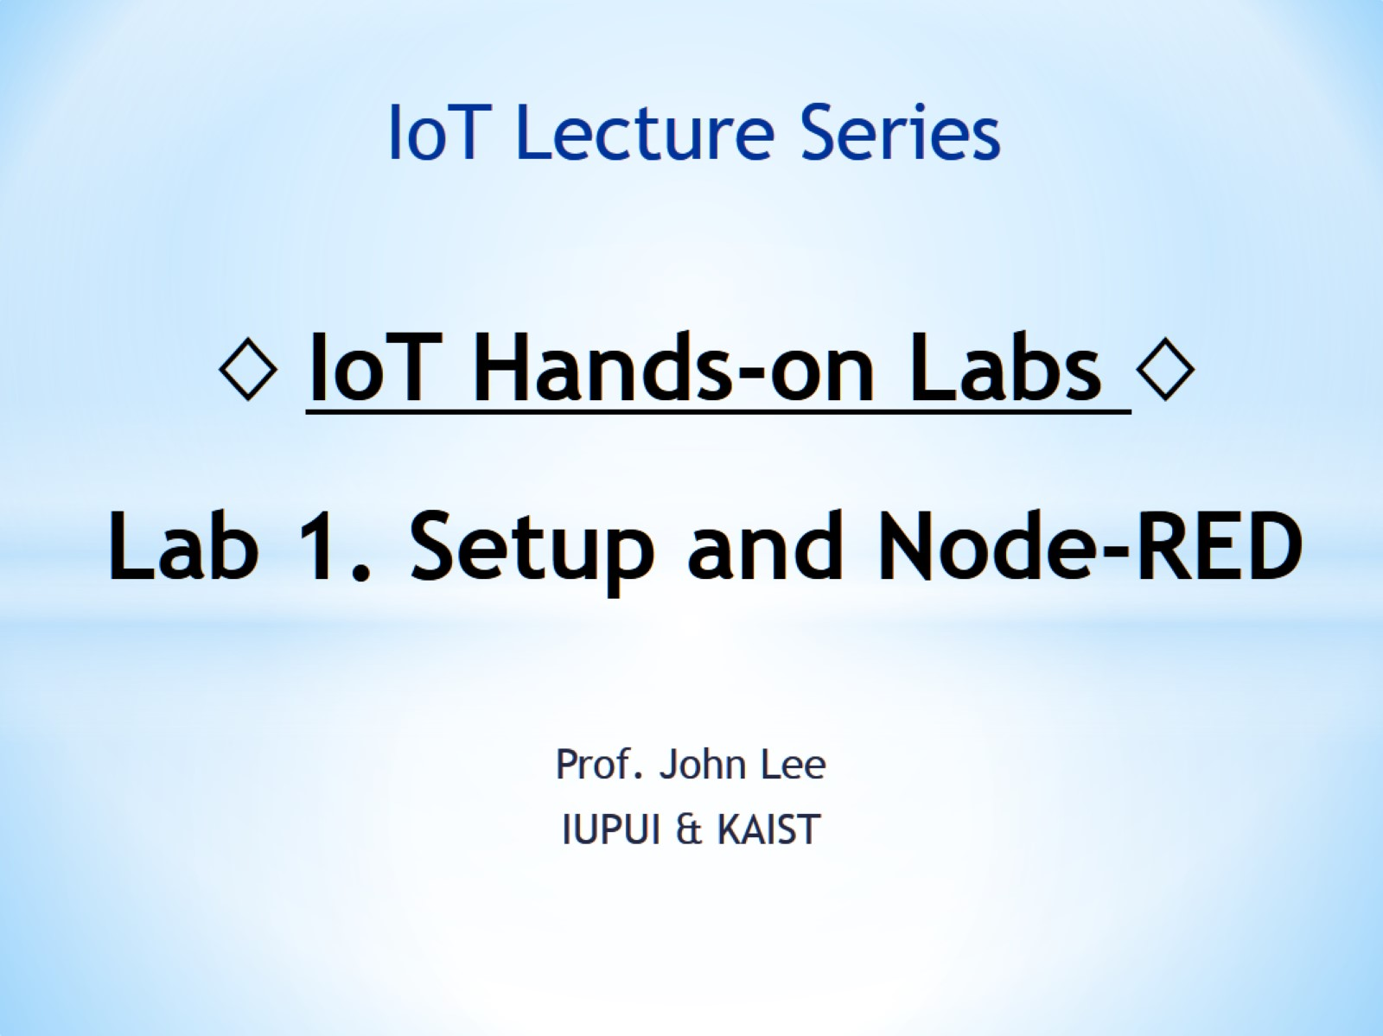
◊ IoT Hands-on Labs ◊ Lab 1. Setup and Node-RED

Slide 2
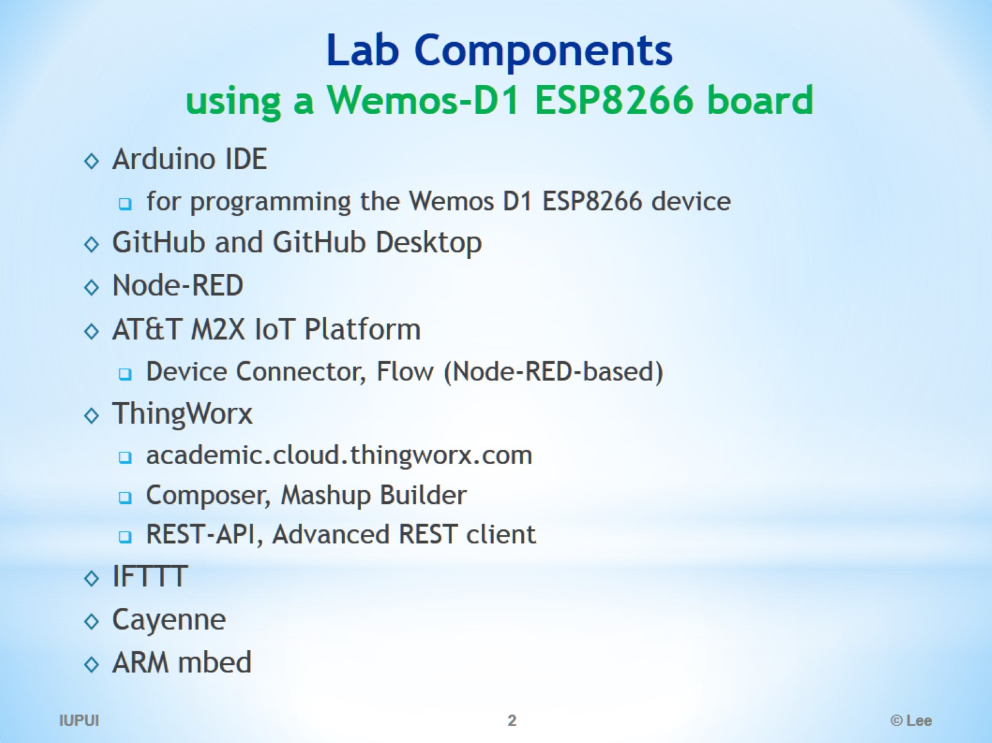
Lab Components using a Wemos-D1 ESP8266 board

Slide 3
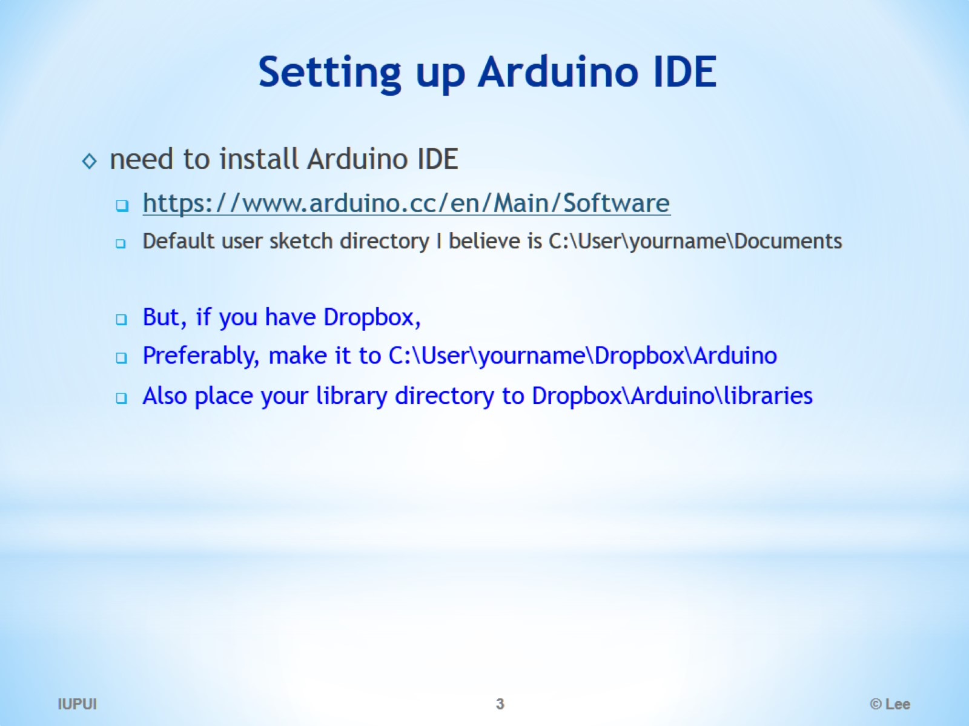
Setting up Arduino IDE

Slide 4
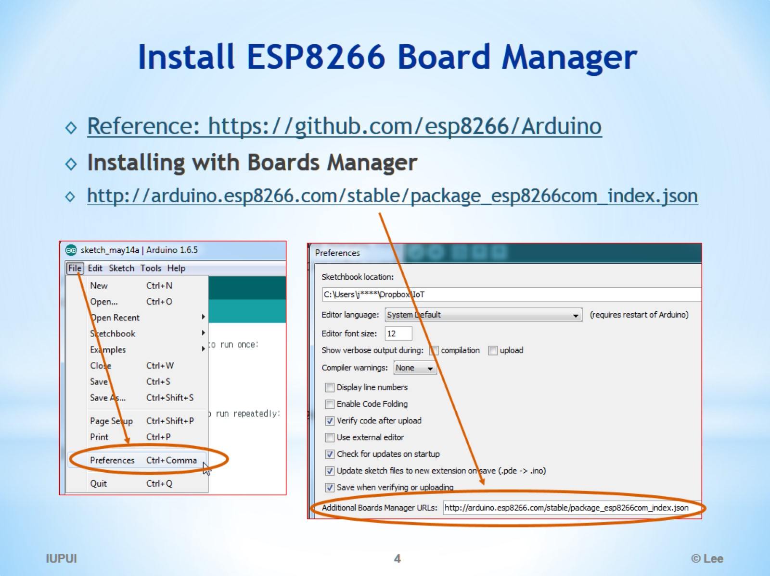
Install ESP8266 Board Manager

Slide 5
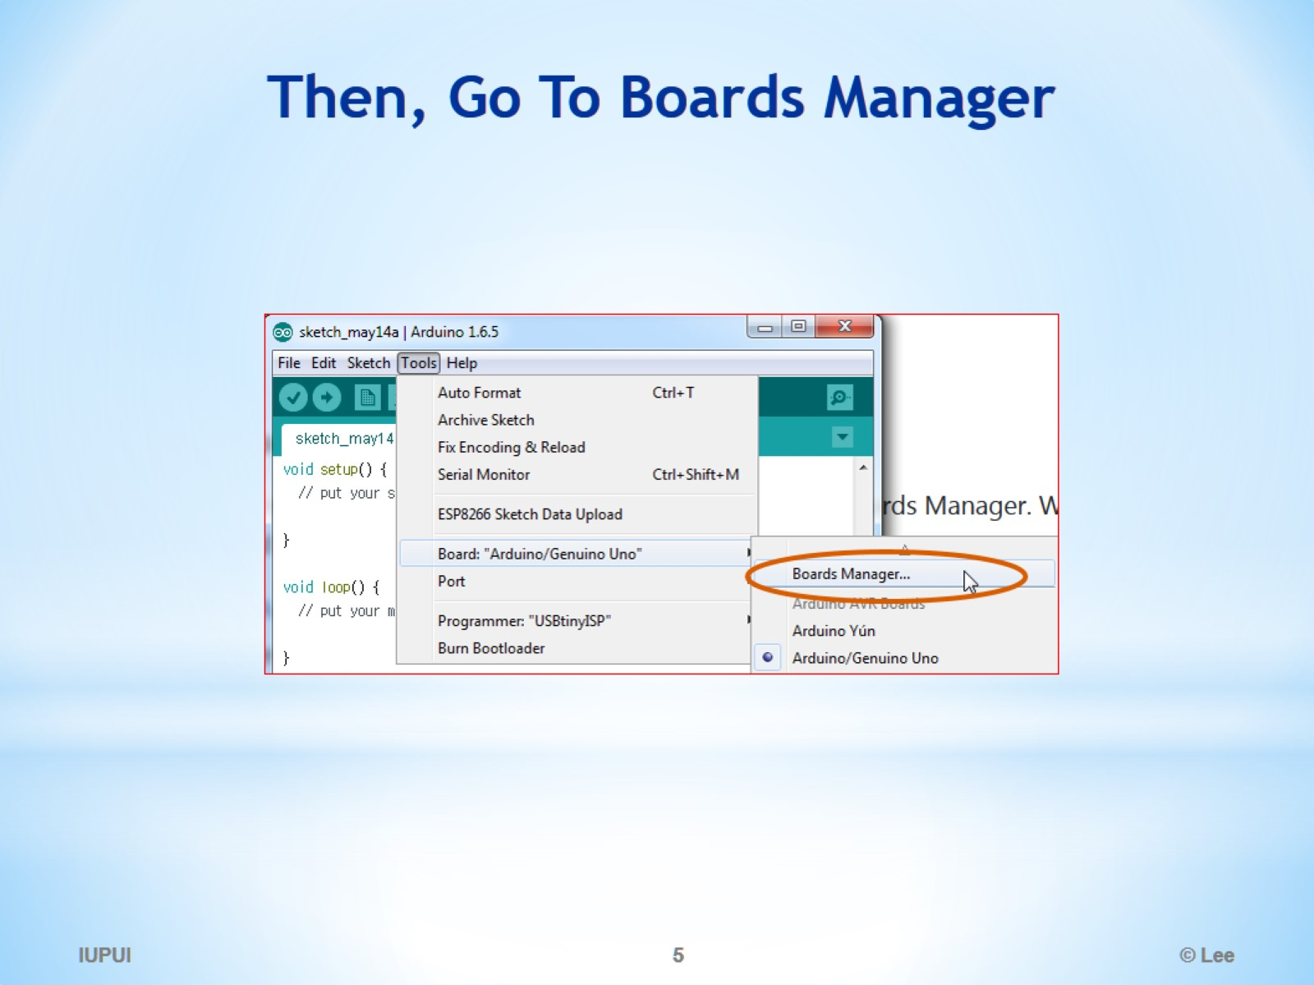
Then, Go To Boards Manager

Slide 6
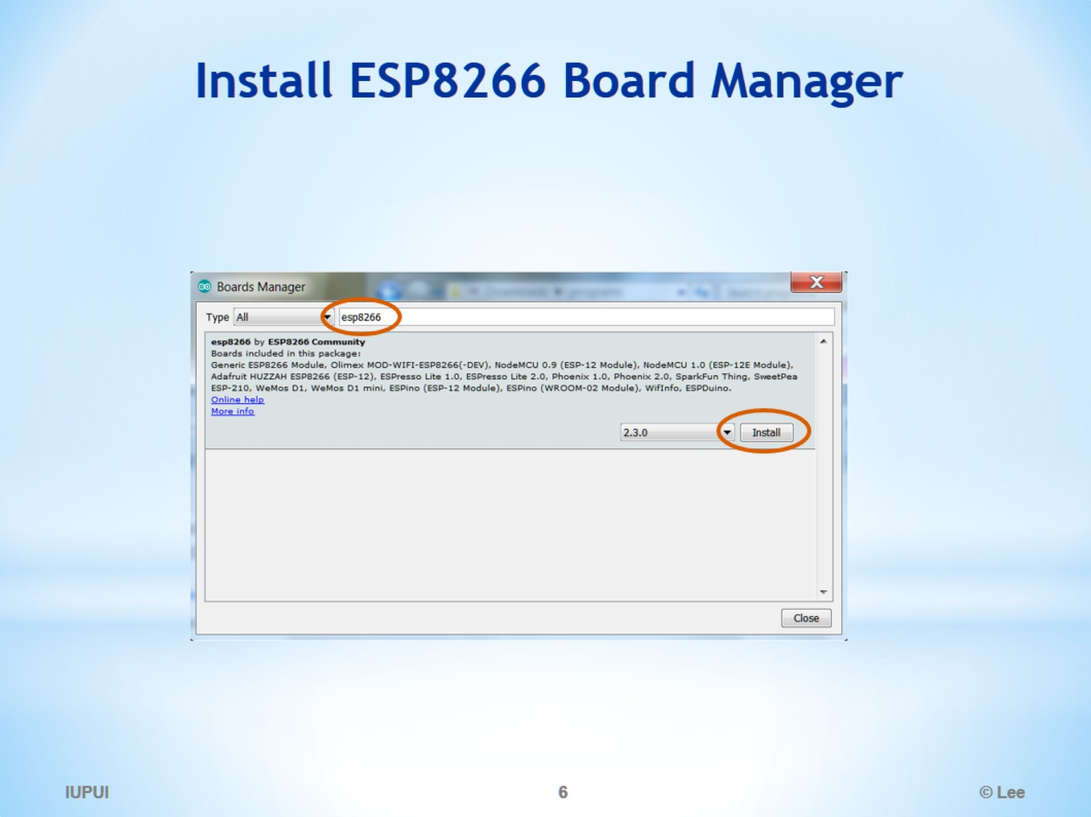
Install ESP8266 Board Manager

Slide 7
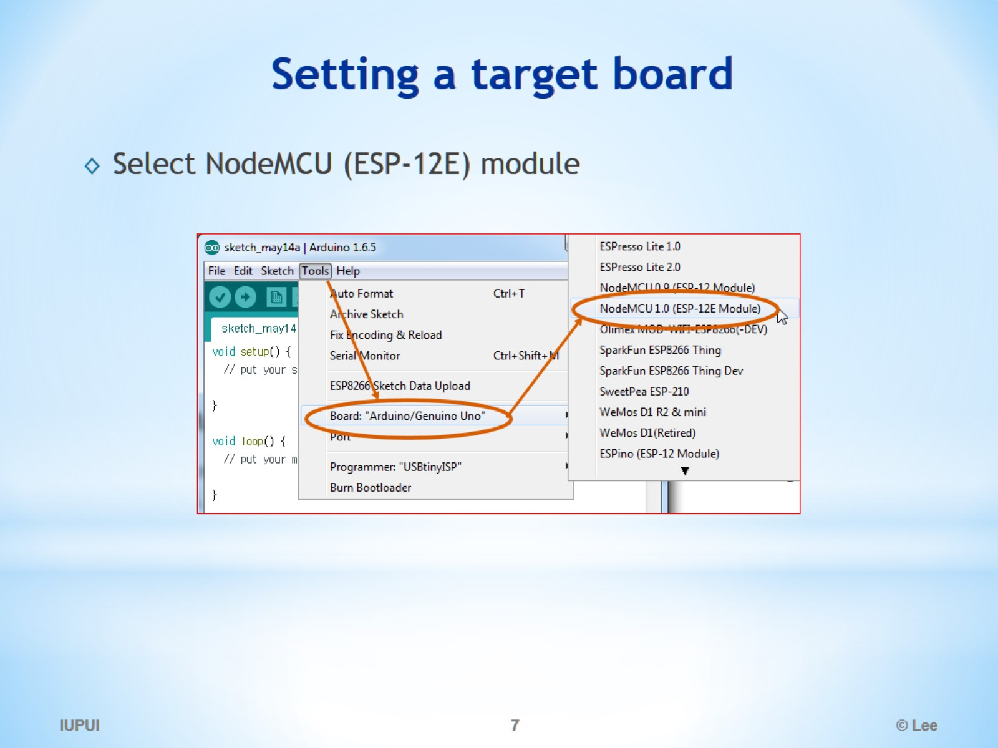
Setting a target board

Slide 8
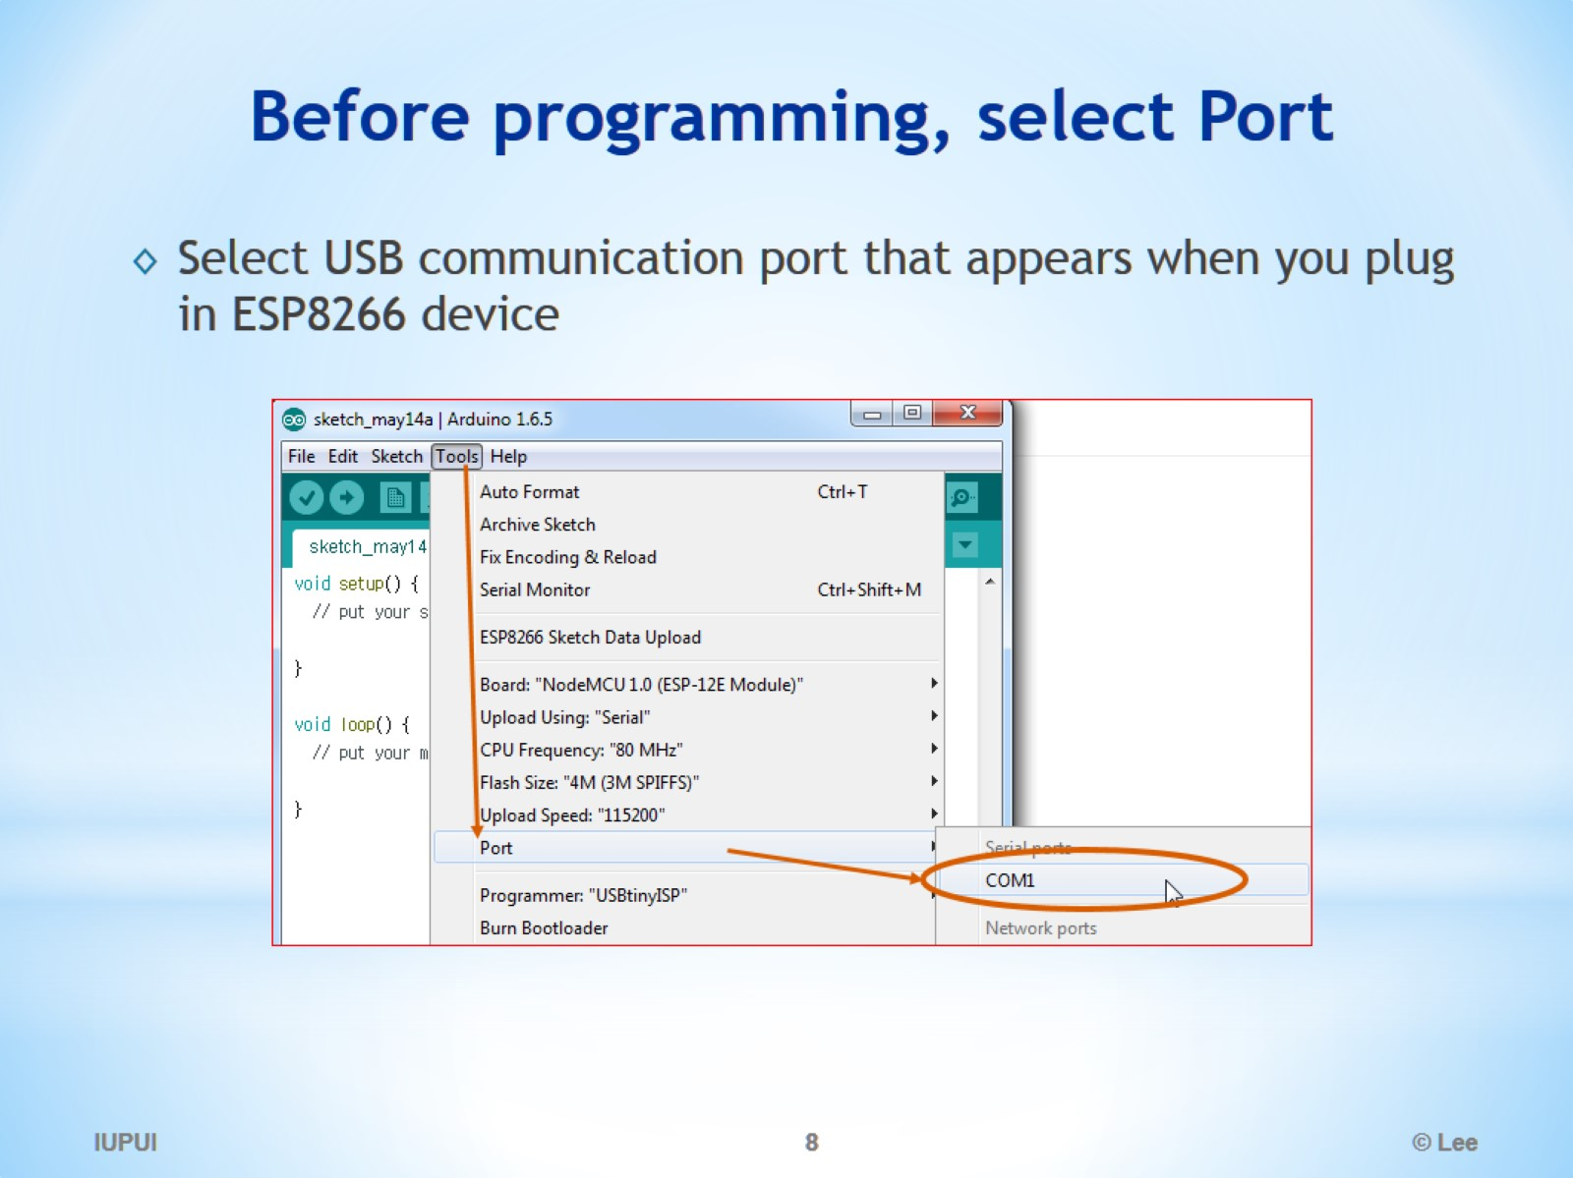
Before programming, select Port

Slide 9
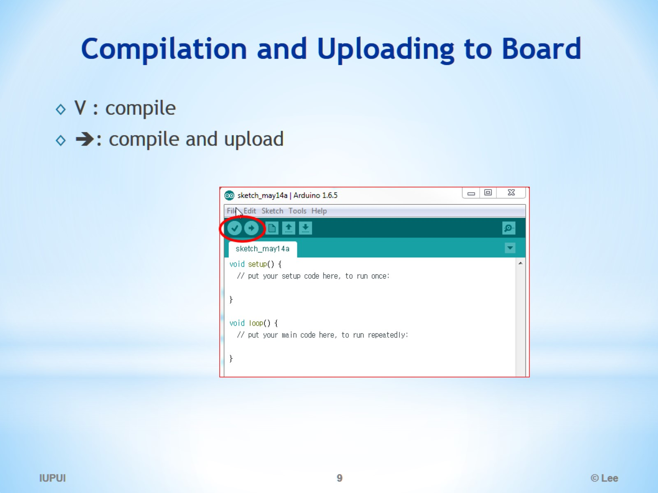
Compilation and Uploading to Board

Slide 10
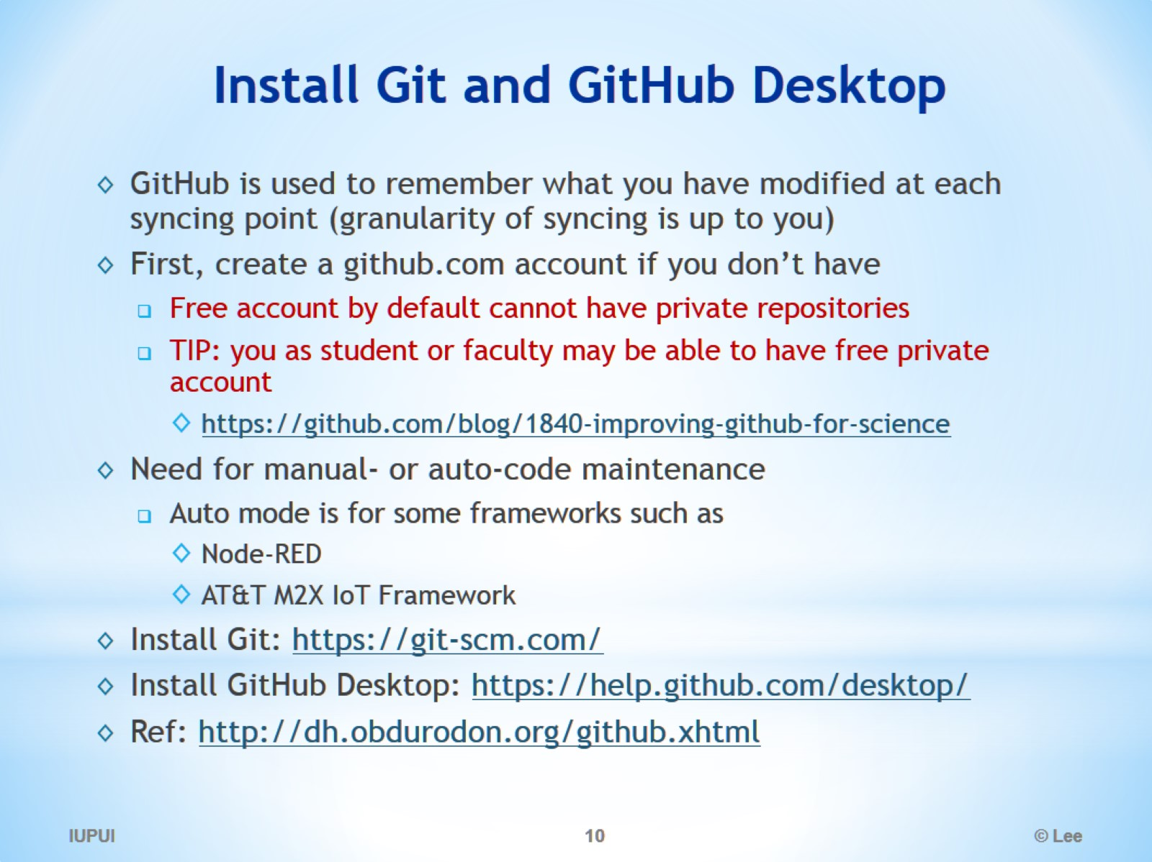
Install Git and GitHub Desktop

Slide 11
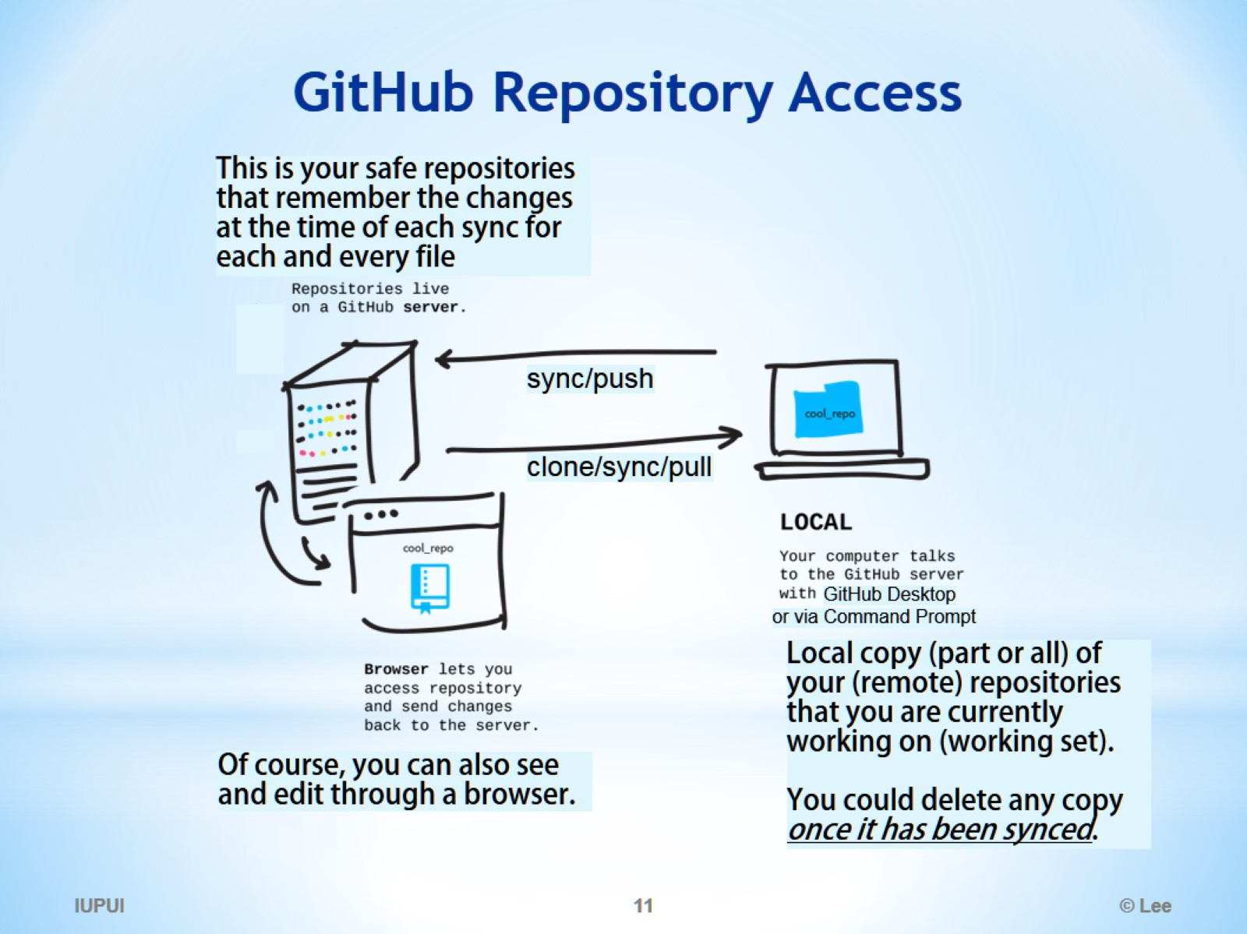
GitHub Repository Access

Slide 12
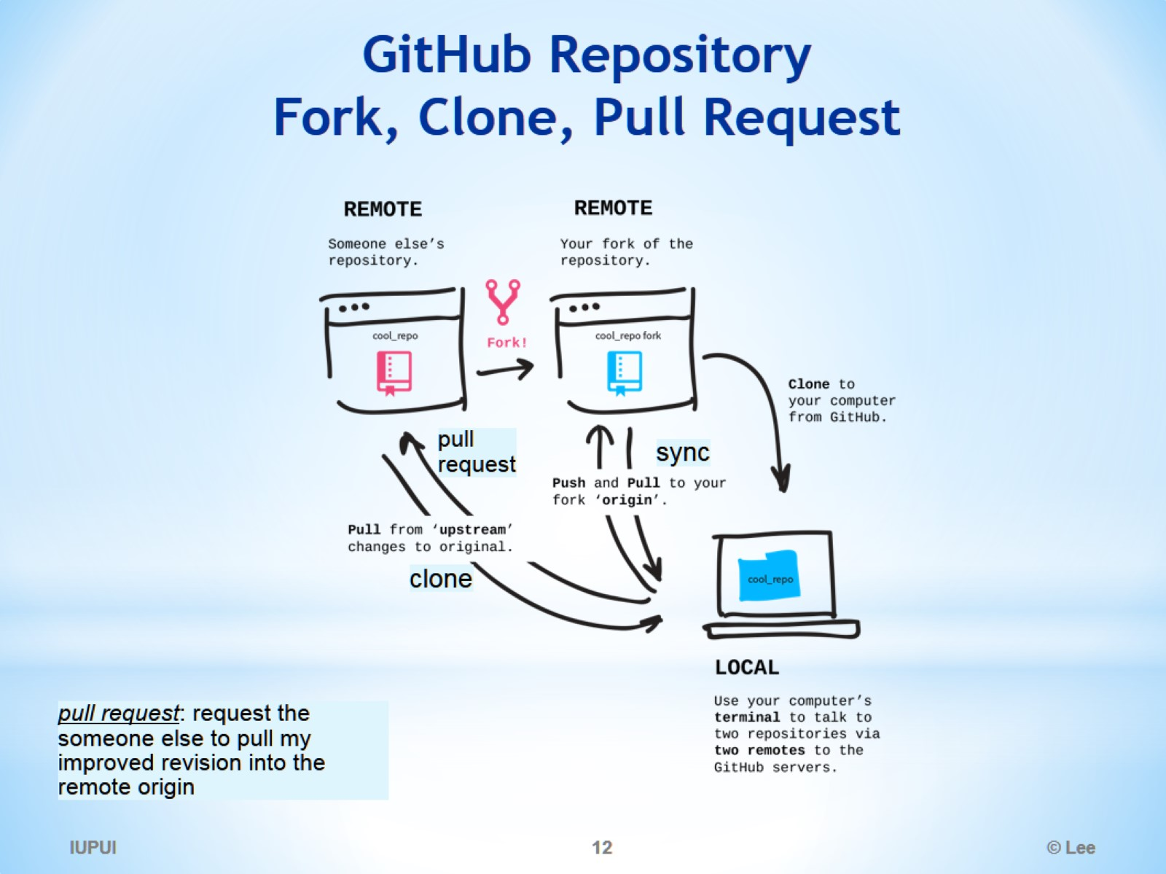
GitHub Repository Fork, Clone, Pull Request

Slide 13
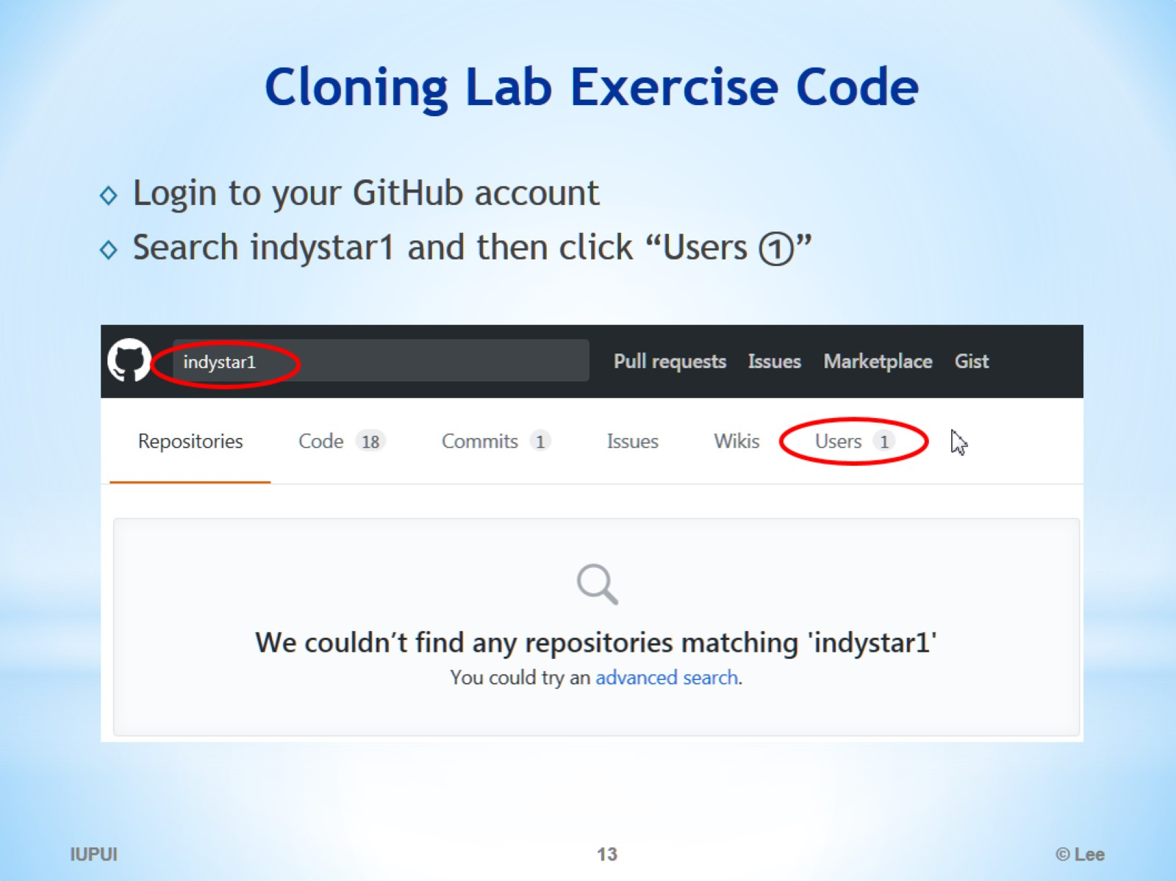
Cloning Lab Exercise Code

Slide 14
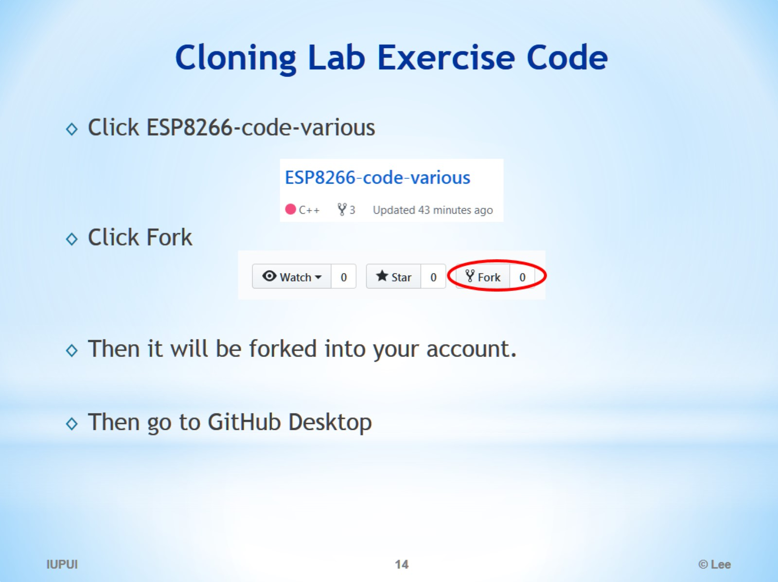
Cloning Lab Exercise Code

Slide 15
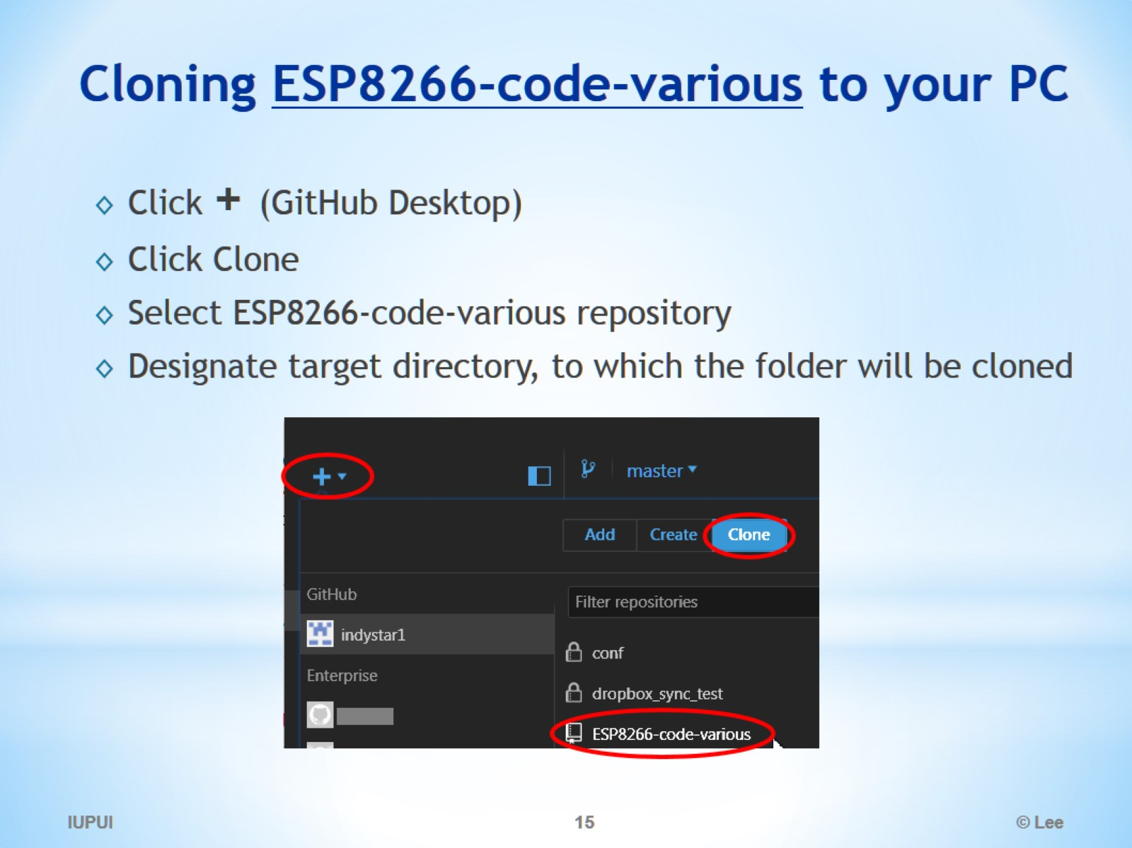
Cloning ESP8266-code-various to your PC

Slide 16
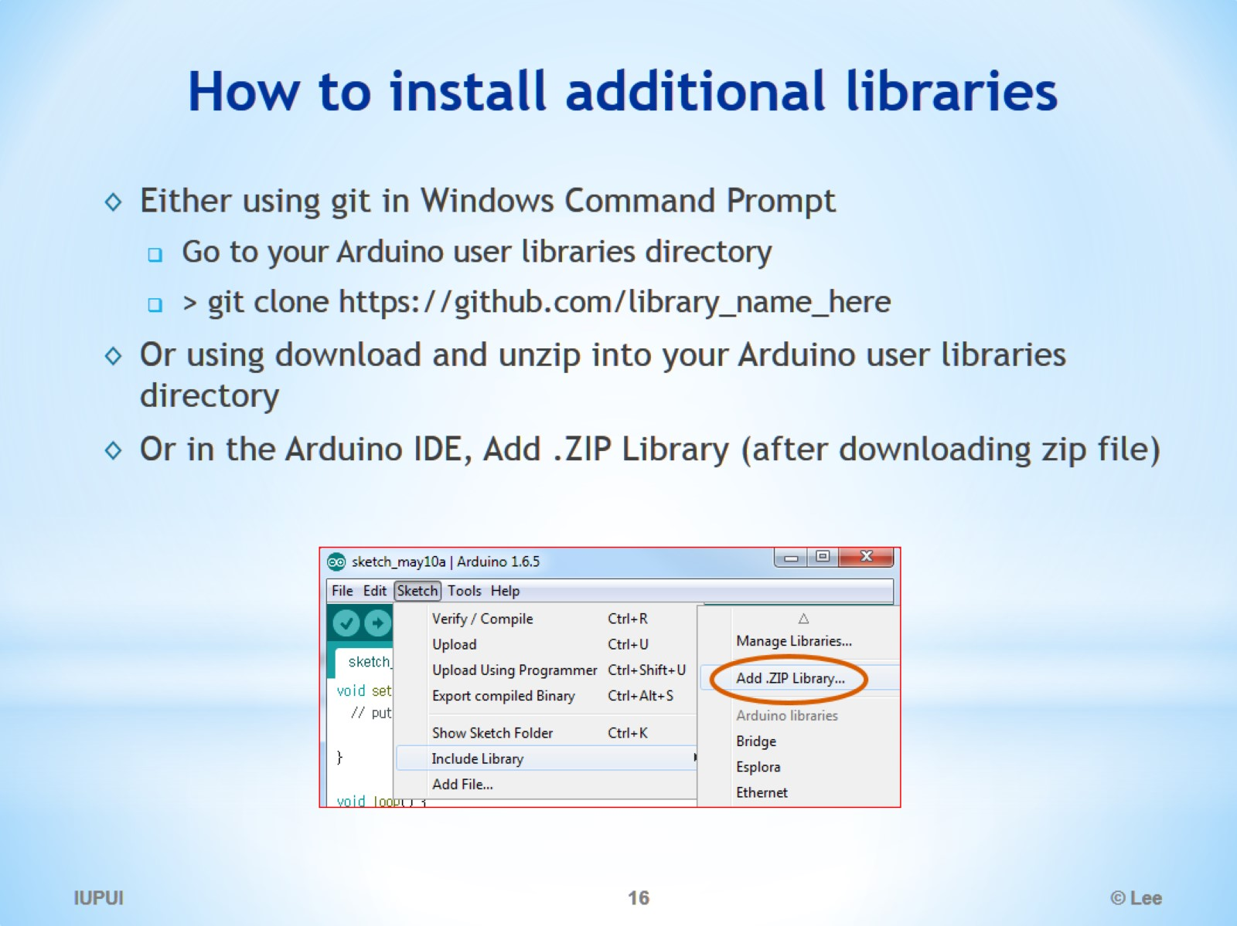
How to install additional libraries

Slide 17
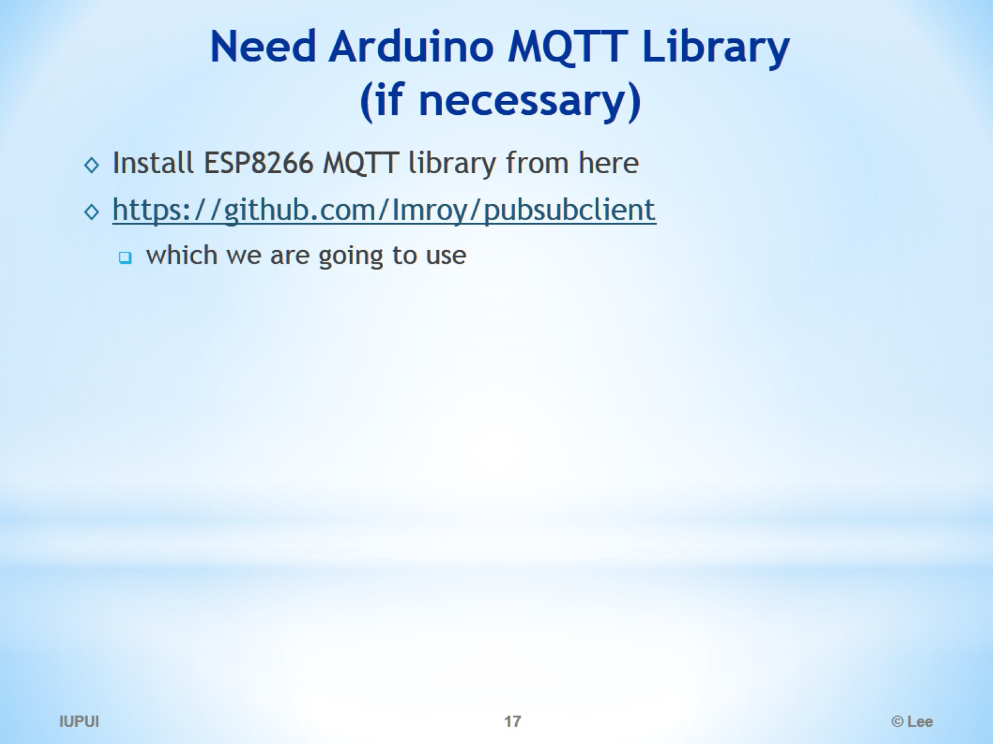
Need Arduino MQTT Library (if necessary)

Slide 18
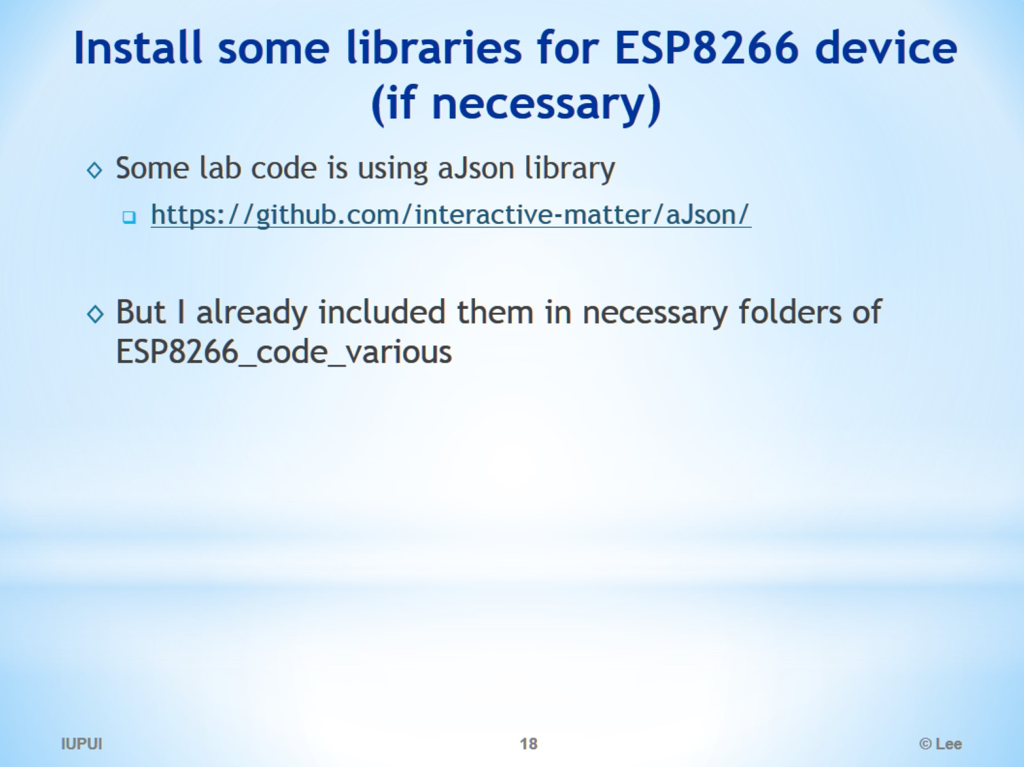
Install some libraries for ESP8266 device (if necessary)

Slide 19
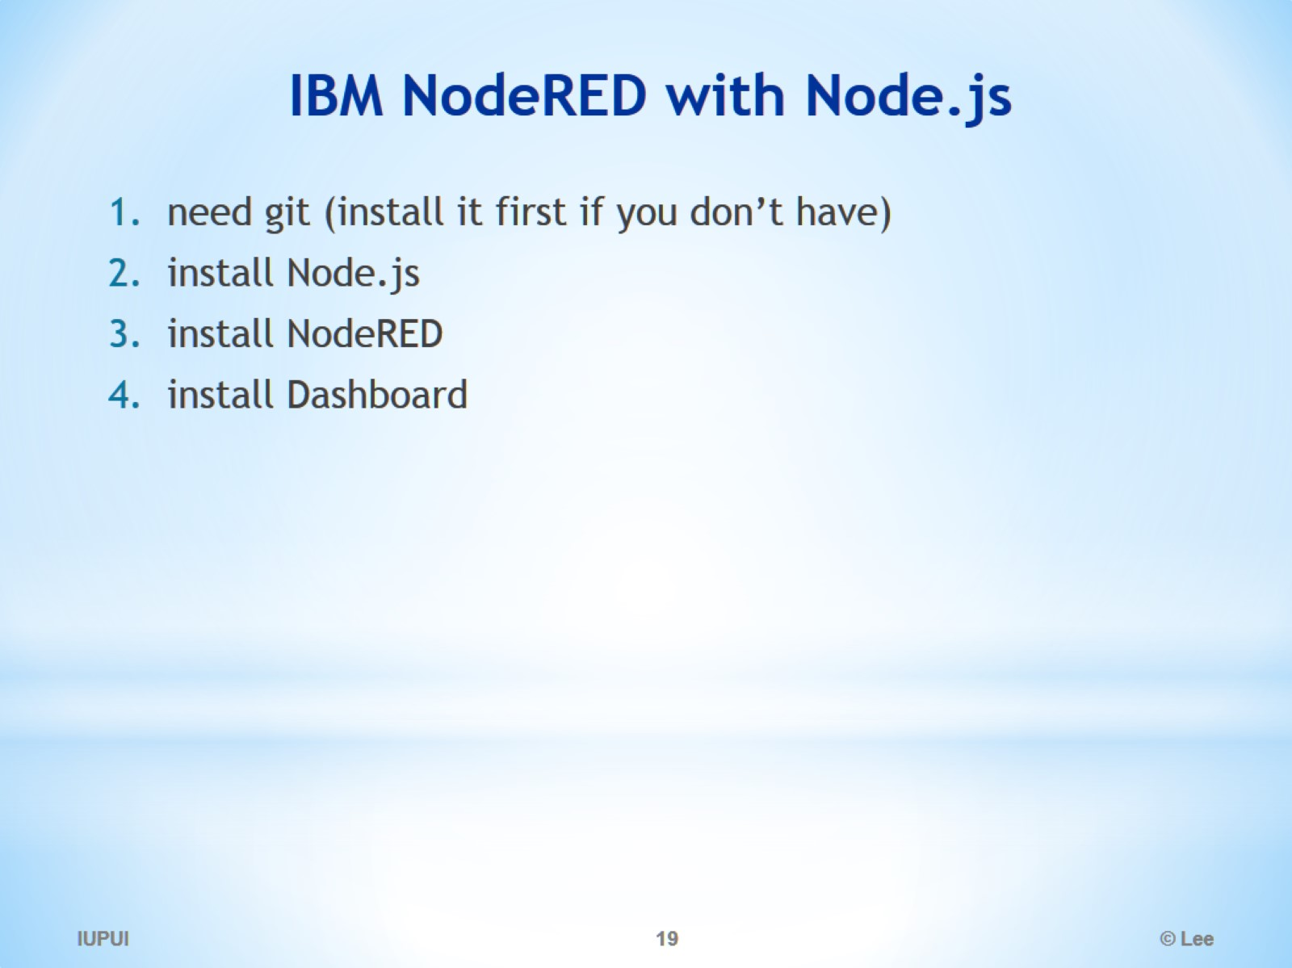
IBM NodeRED with Node.js

Slide 20
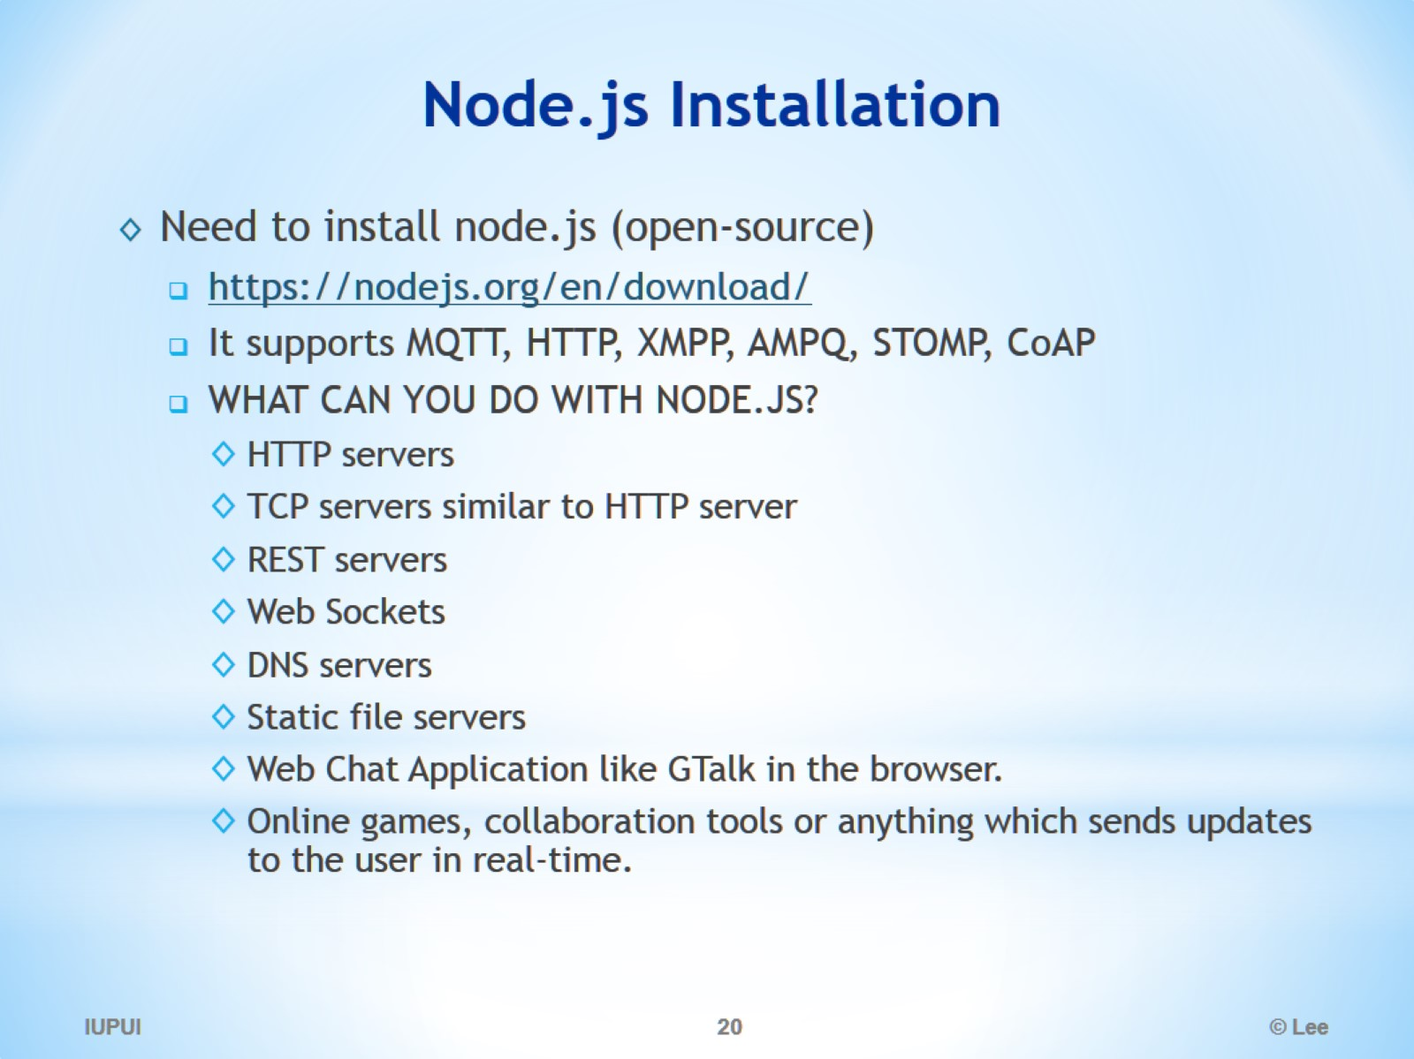
Node.js Installation

Slide 21
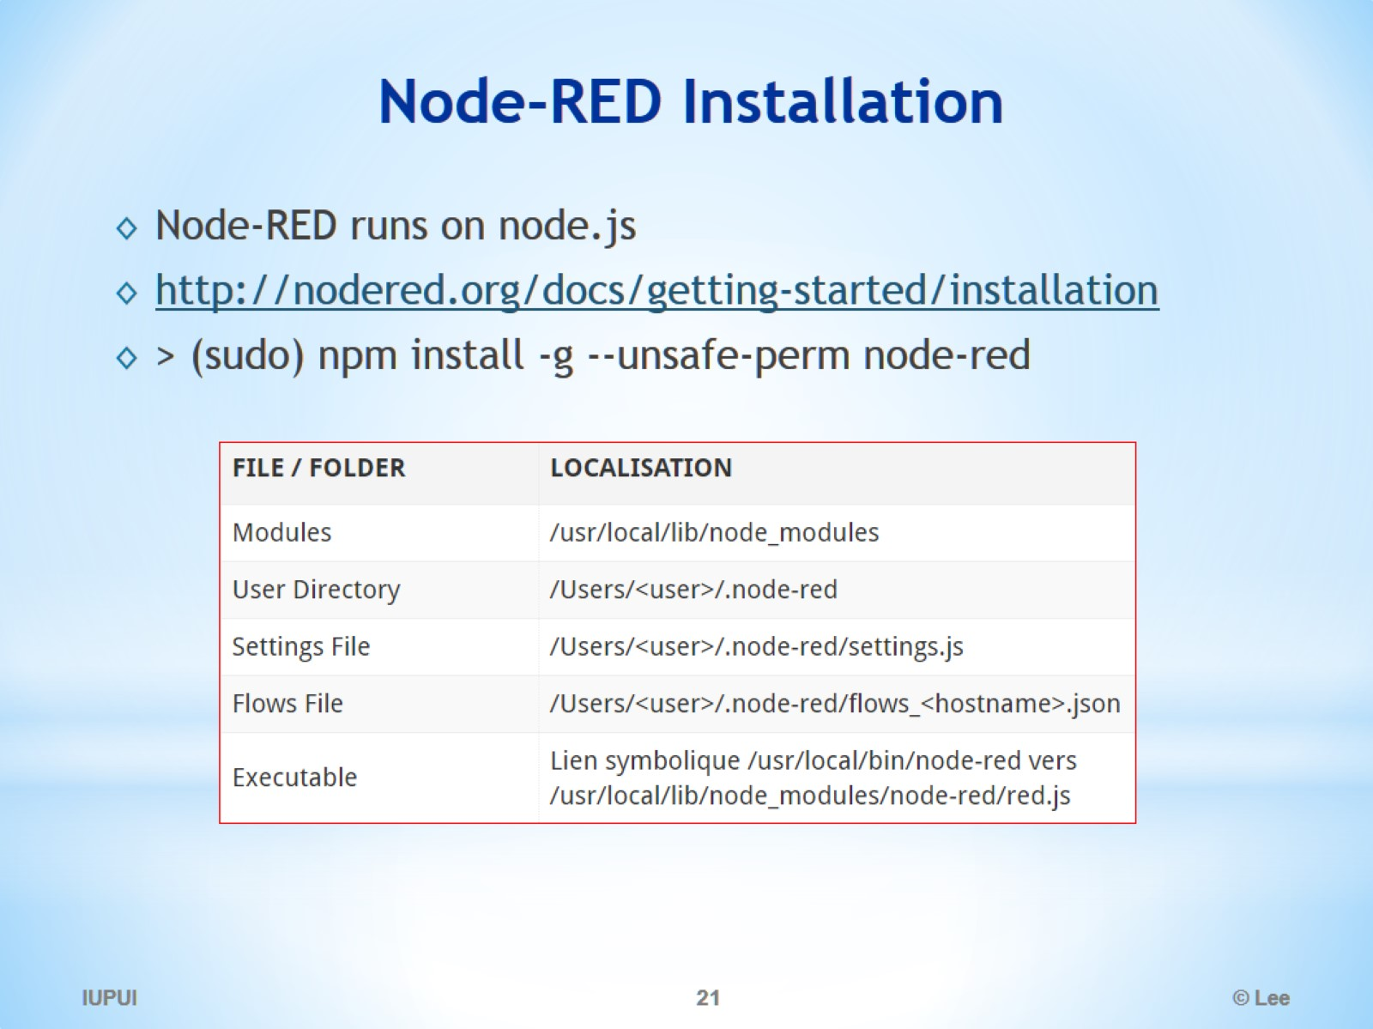
Node-RED Installation

Slide 22
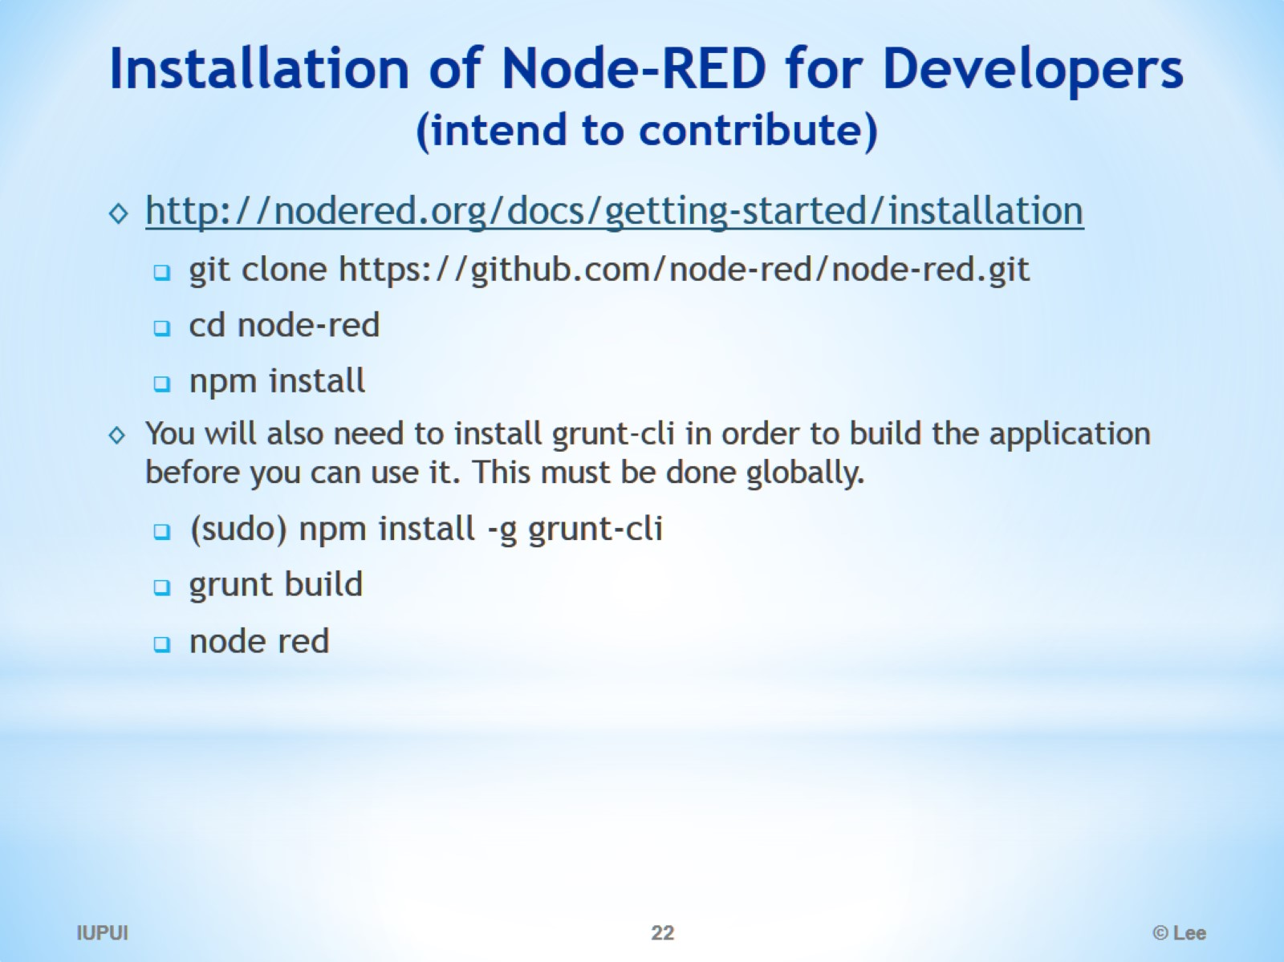
Installation of Node-RED for Developers (intend to contribute)

Slide 23
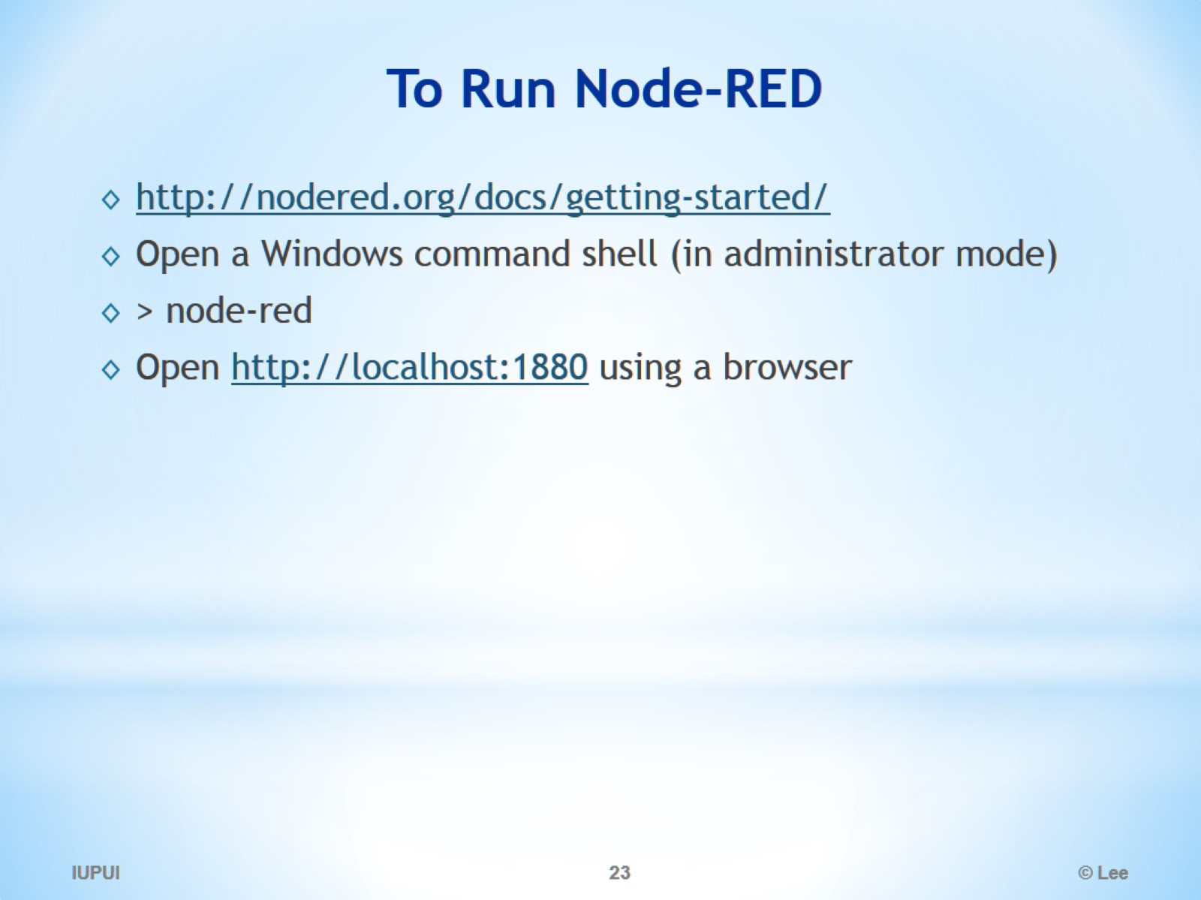
To Run Node-RED

Slide 24
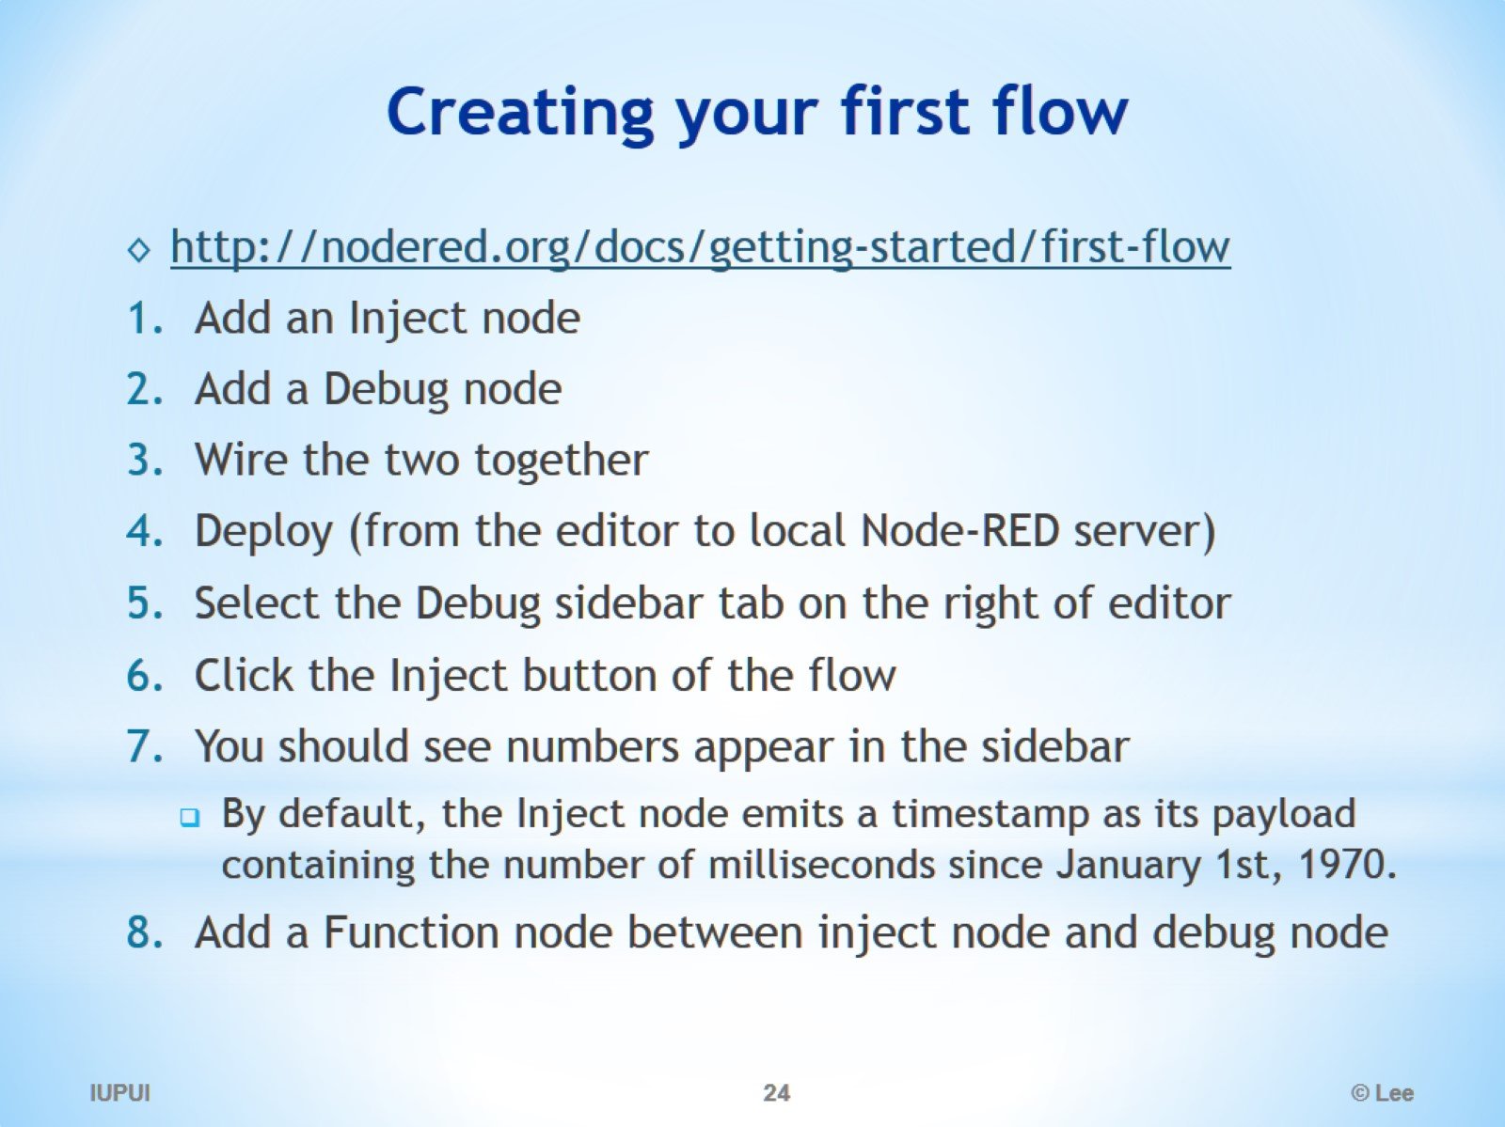
Creating your first flow

Slide 25
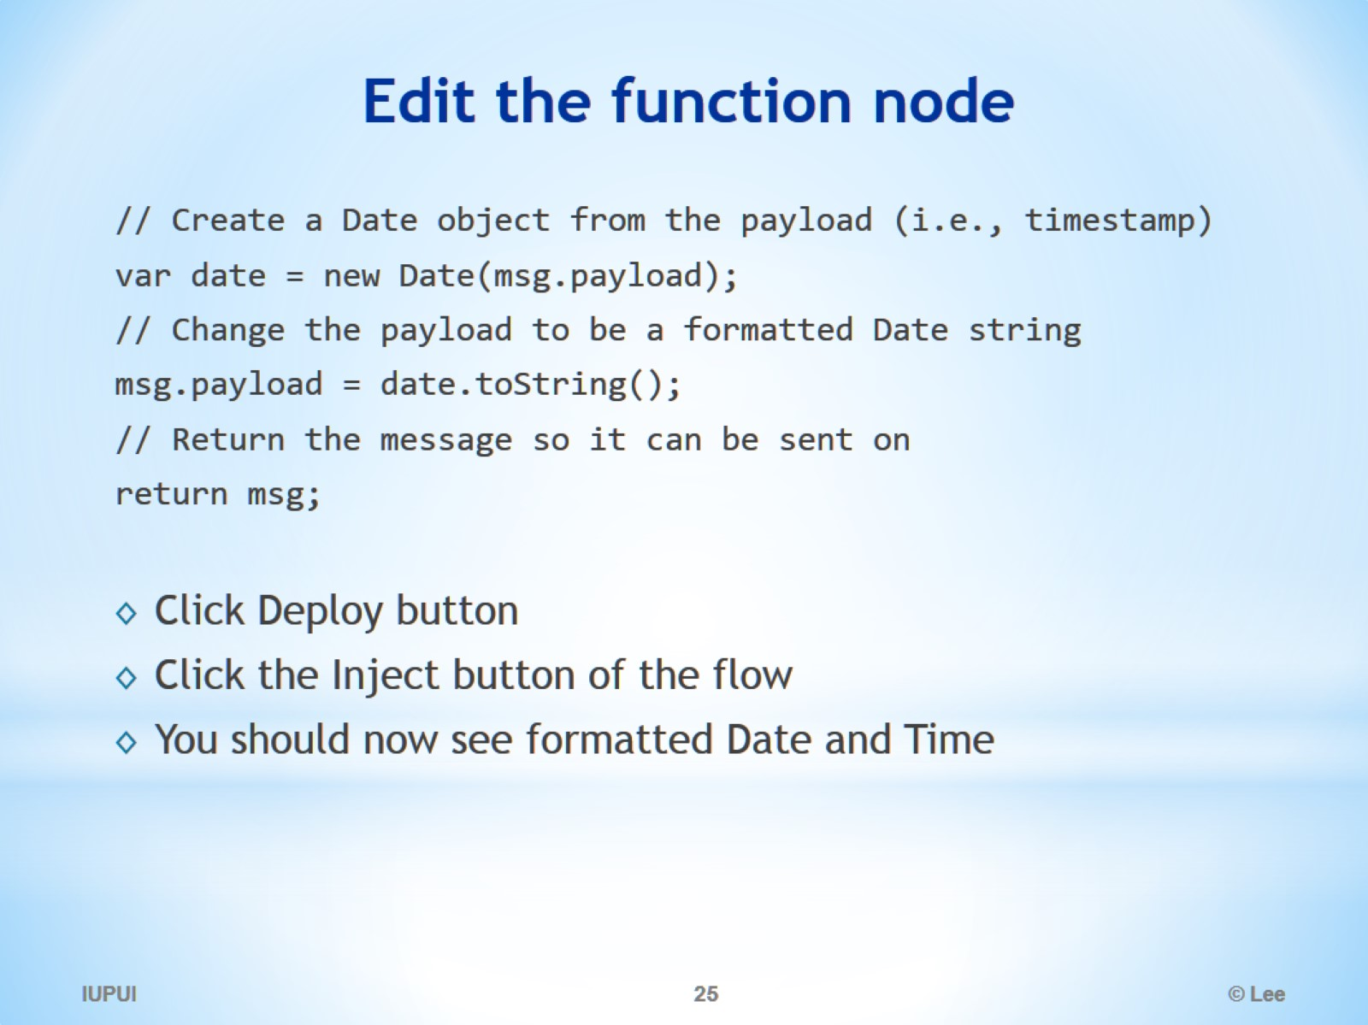
Edit the function node

Slide 26
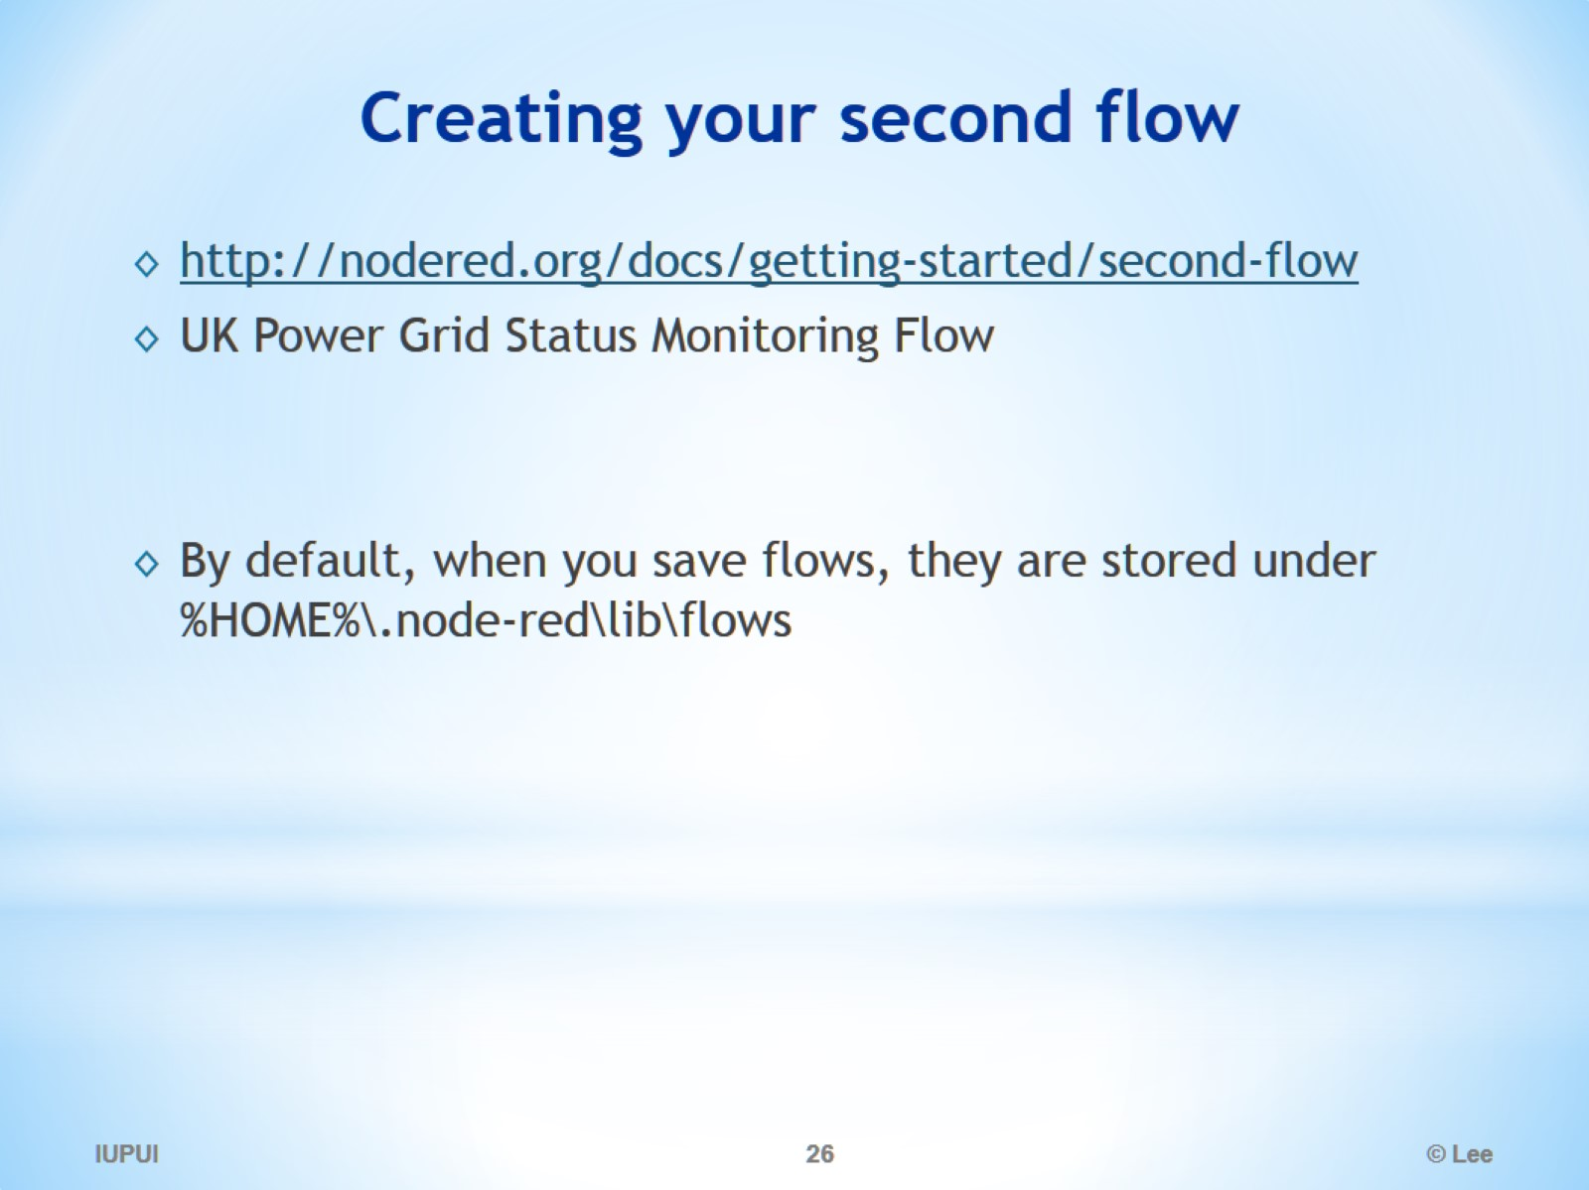
Creating your second flow

Slide 27
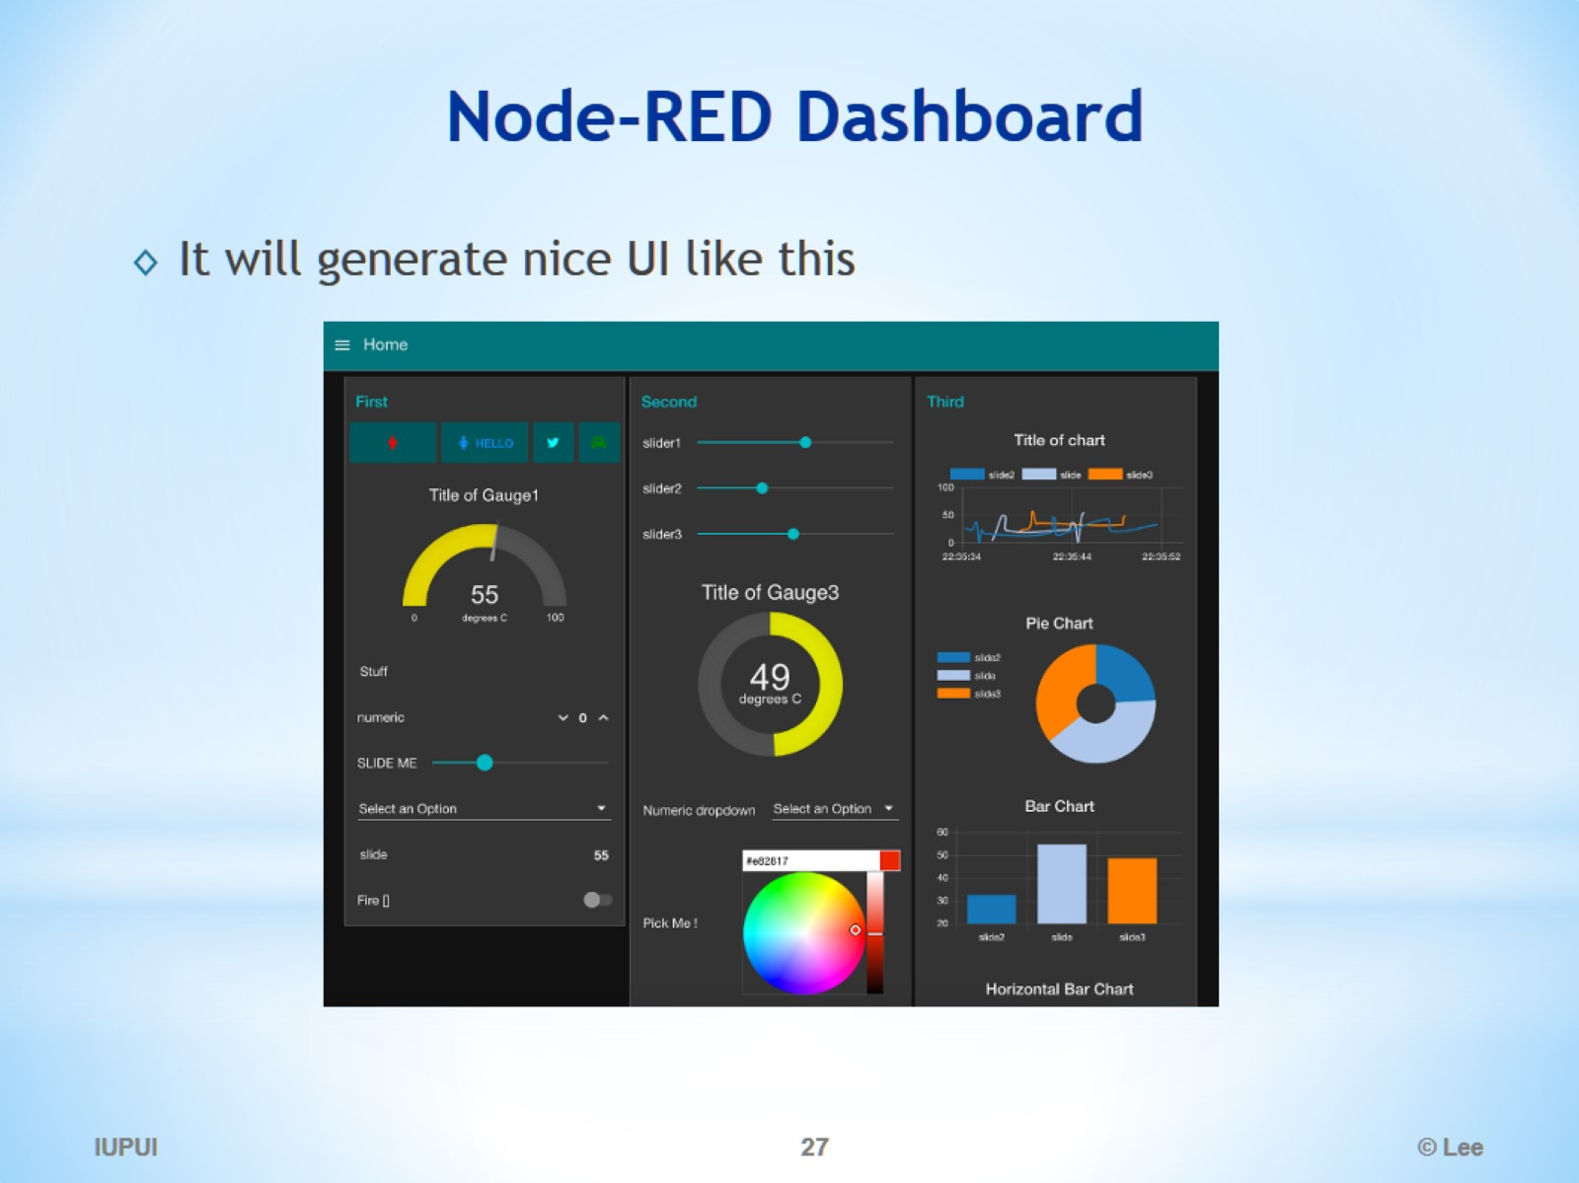
Node-RED Dashboard

Slide 28
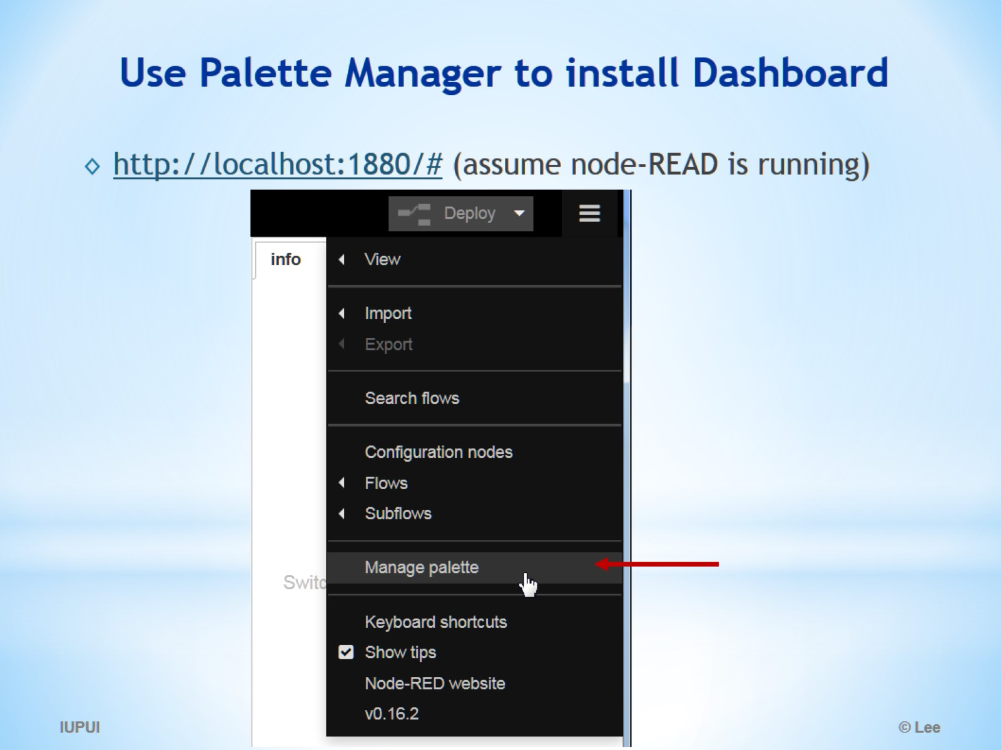
Use Palette Manager to install Dashboard

Slide 29
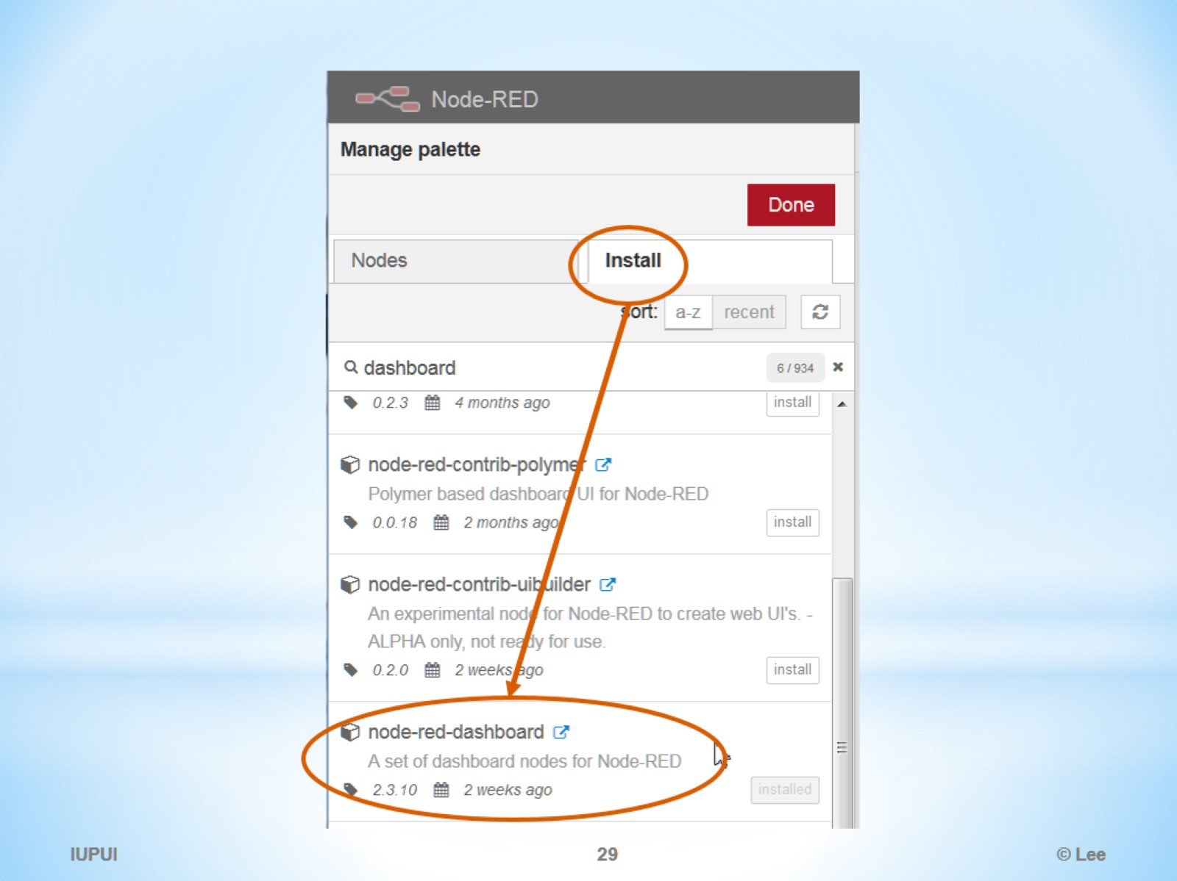

Slide 30
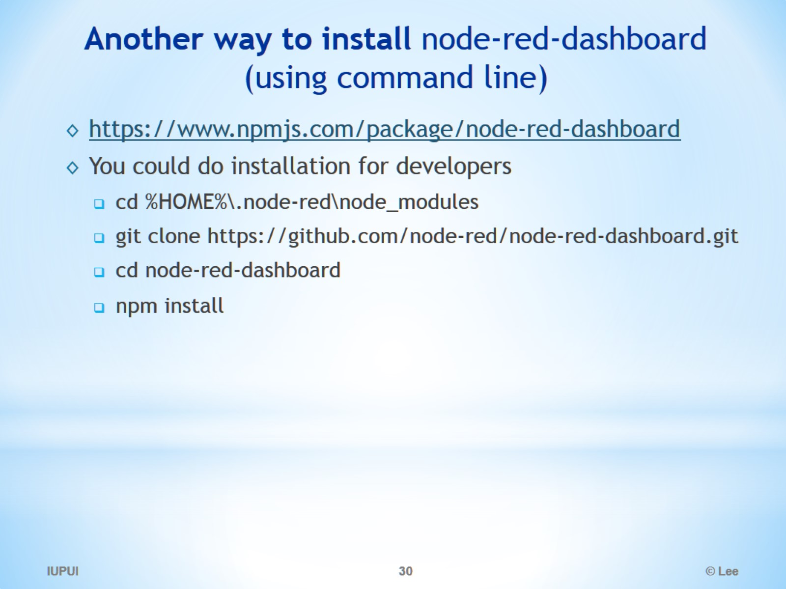
Another way to install node-red-dashboard (using command line)

Slide 31
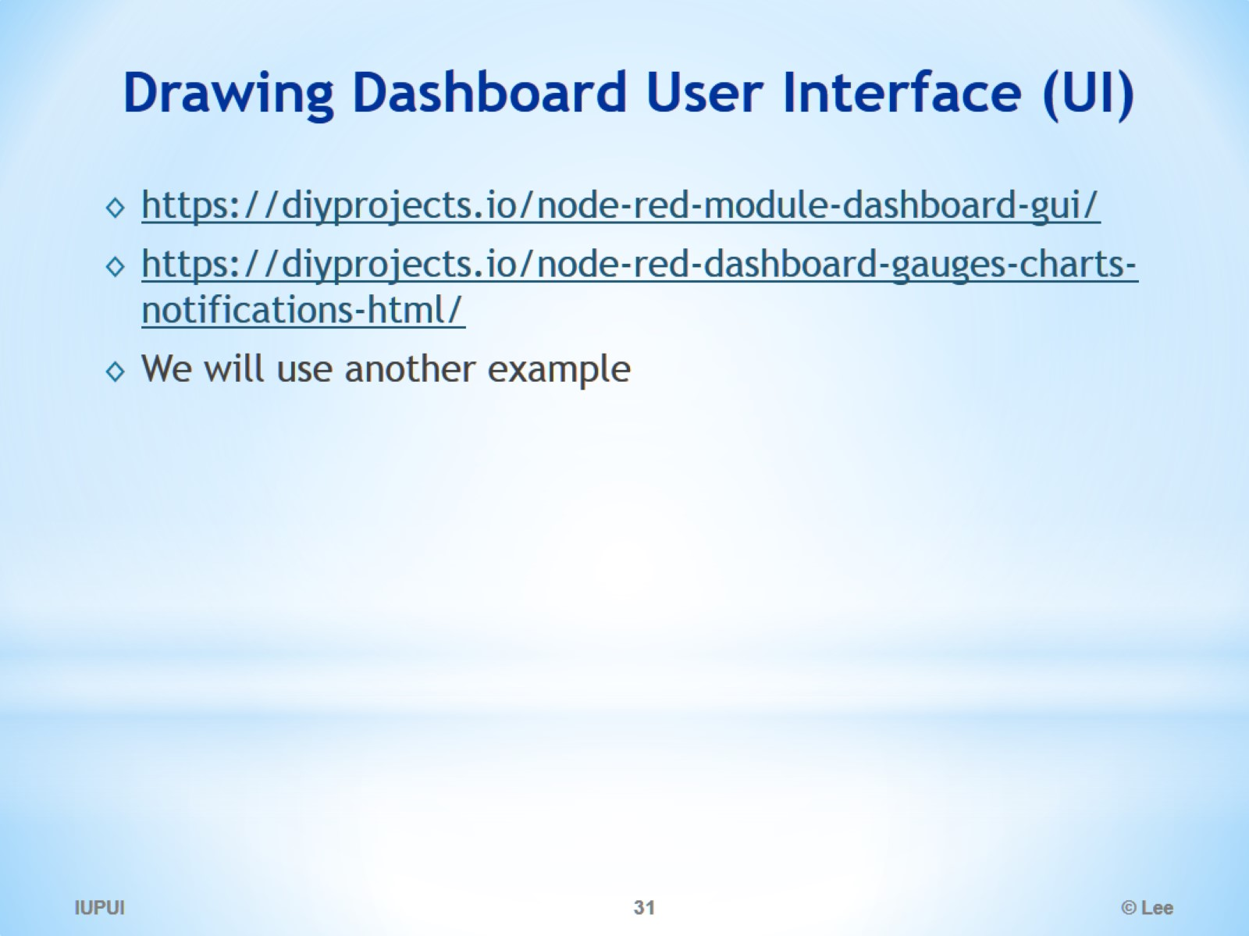
Drawing Dashboard User Interface (UI)

Slide 32
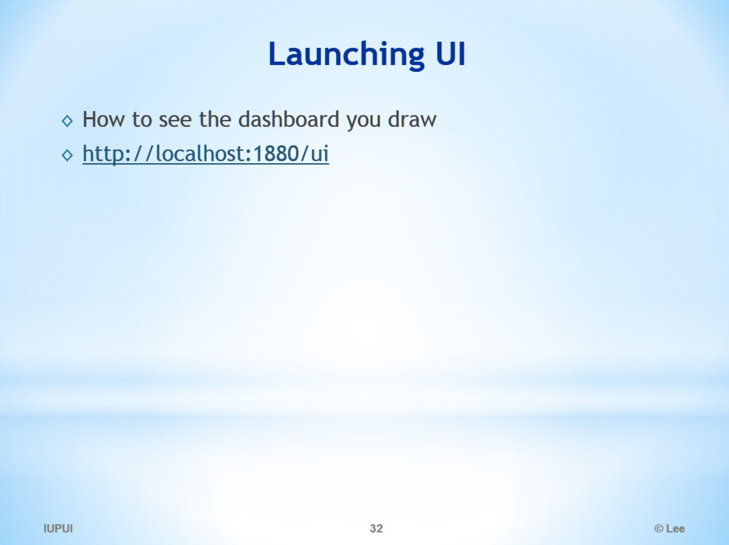
Launching UI

Slide 33
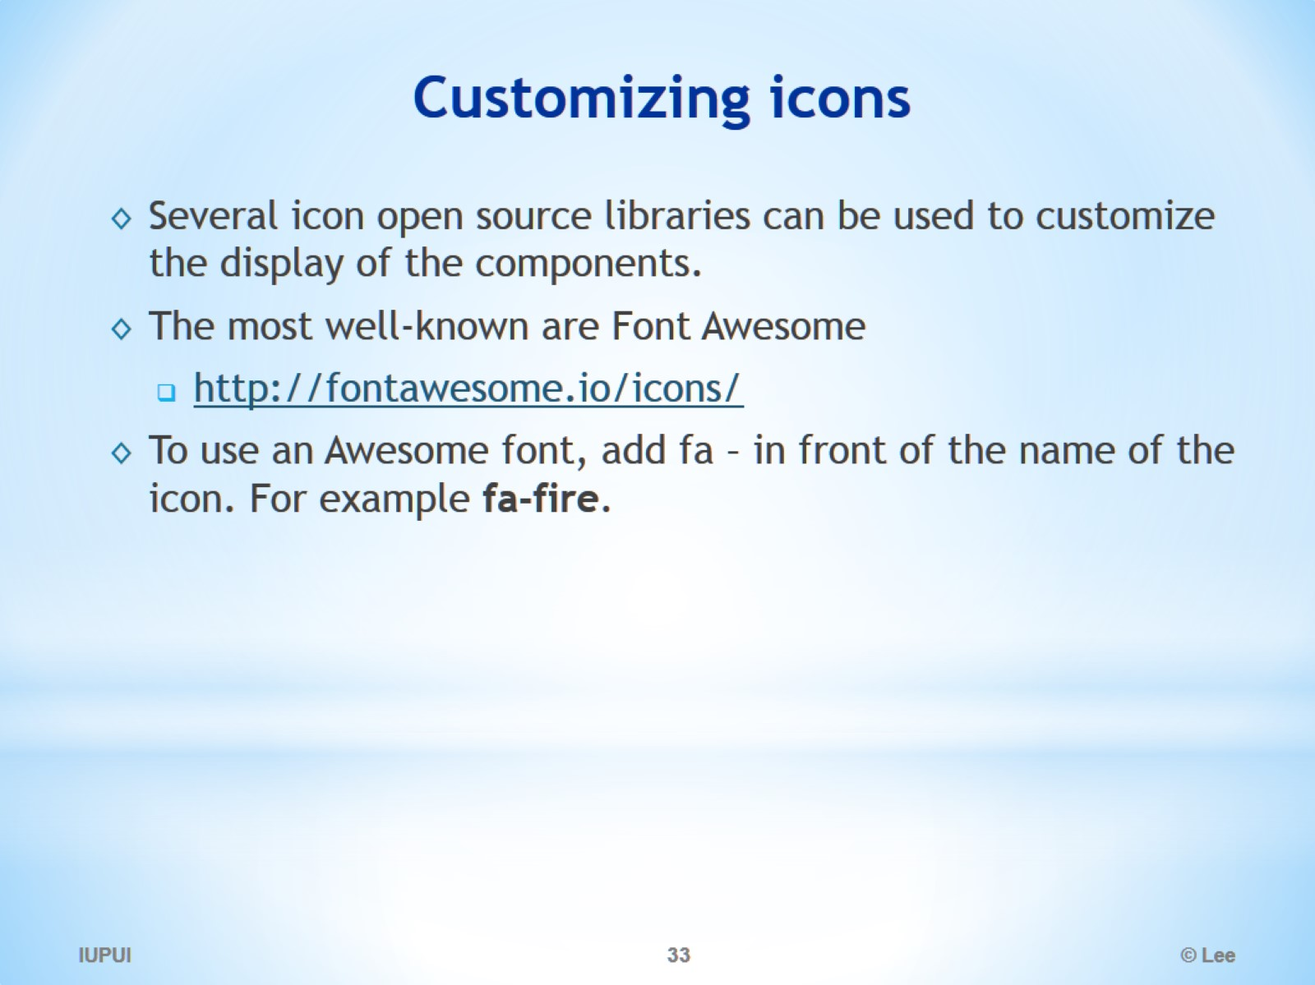
Customizing icons

Slide 34
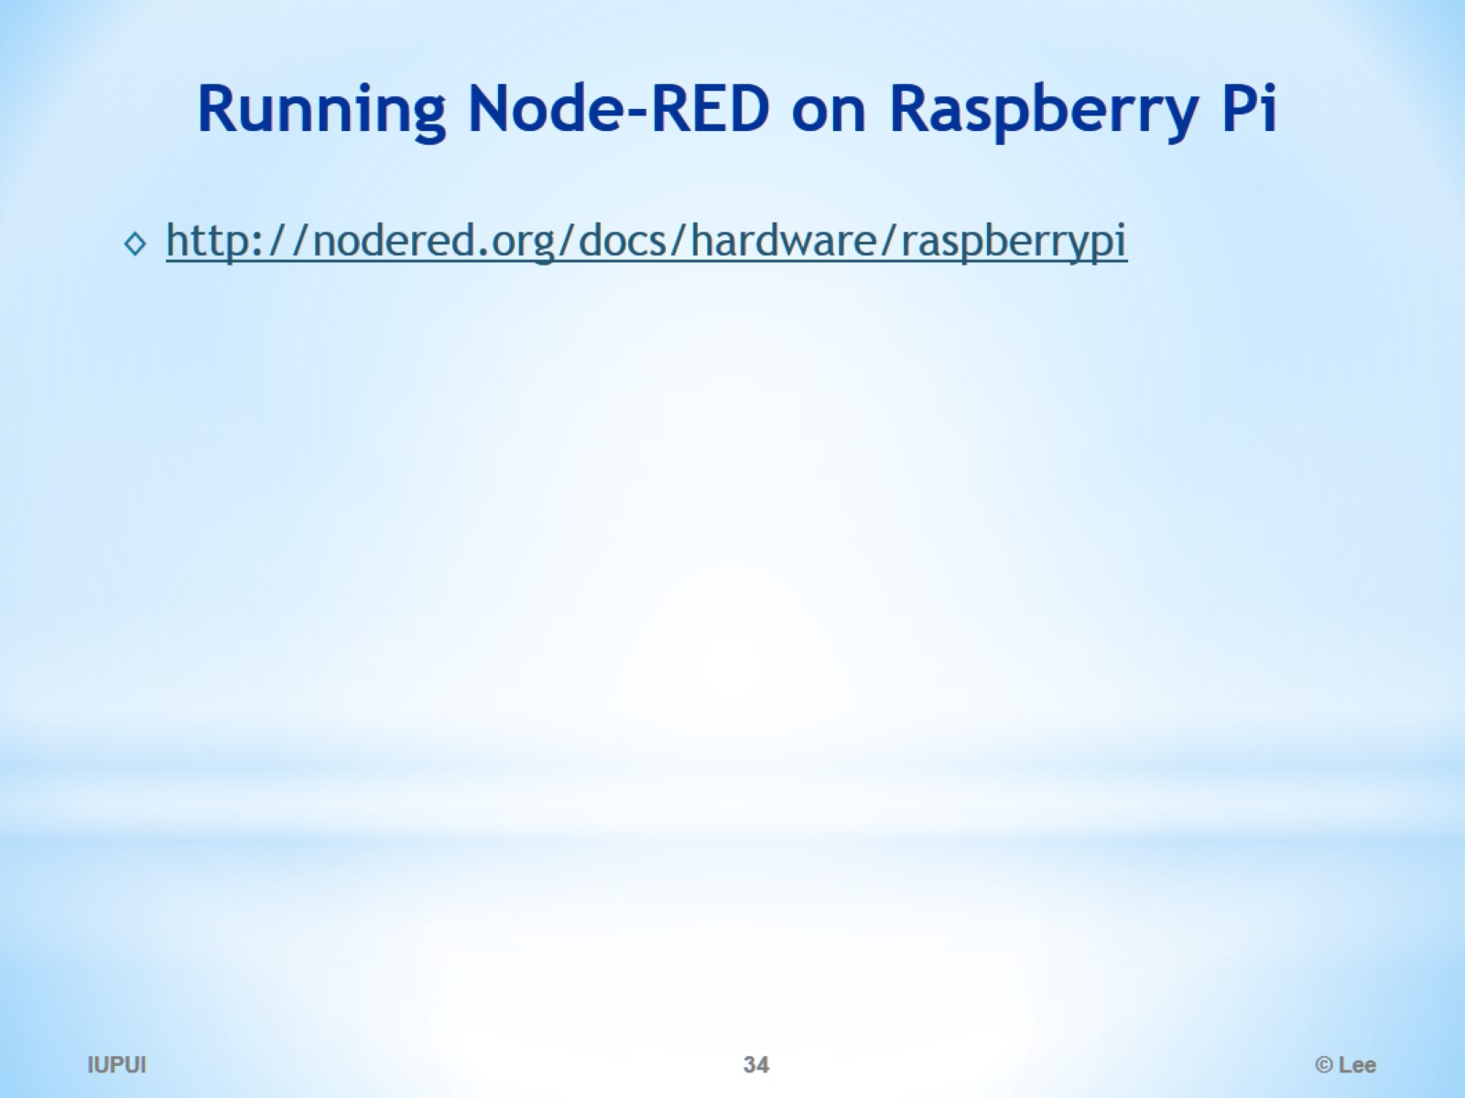
Running Node-RED on Raspberry Pi

Slide 35
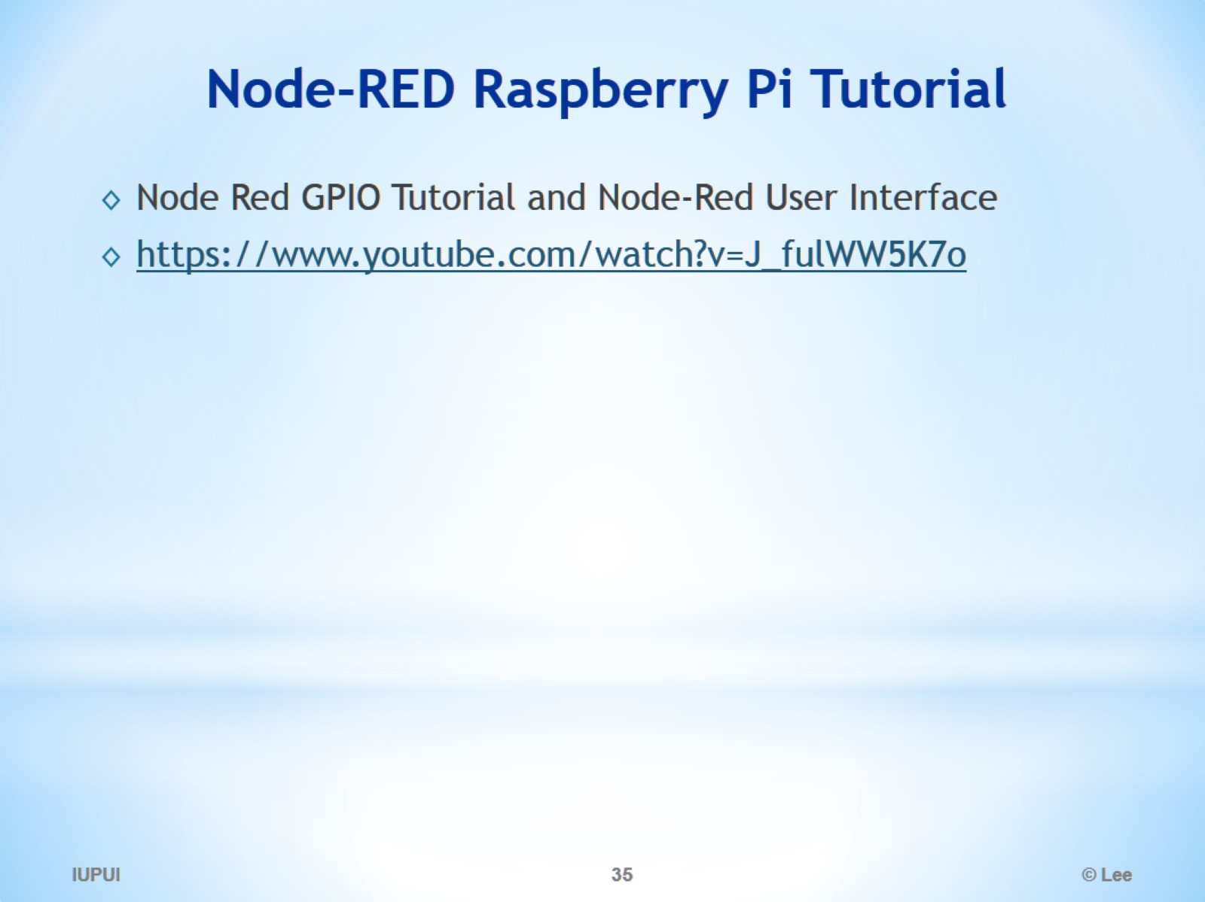
Node-RED Raspberry Pi Tutorial

Slide 36
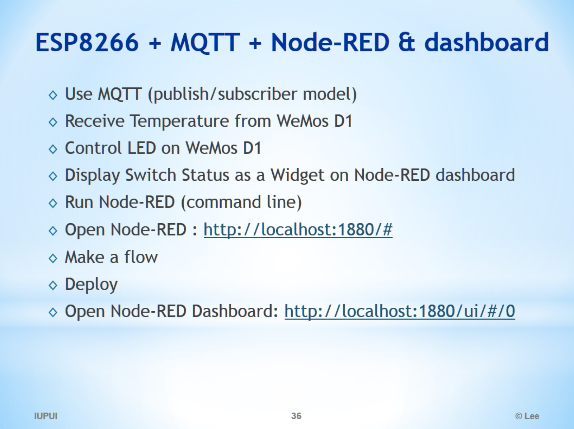
ESP8266 + MQTT + Node-RED & dashboard

Slide 37
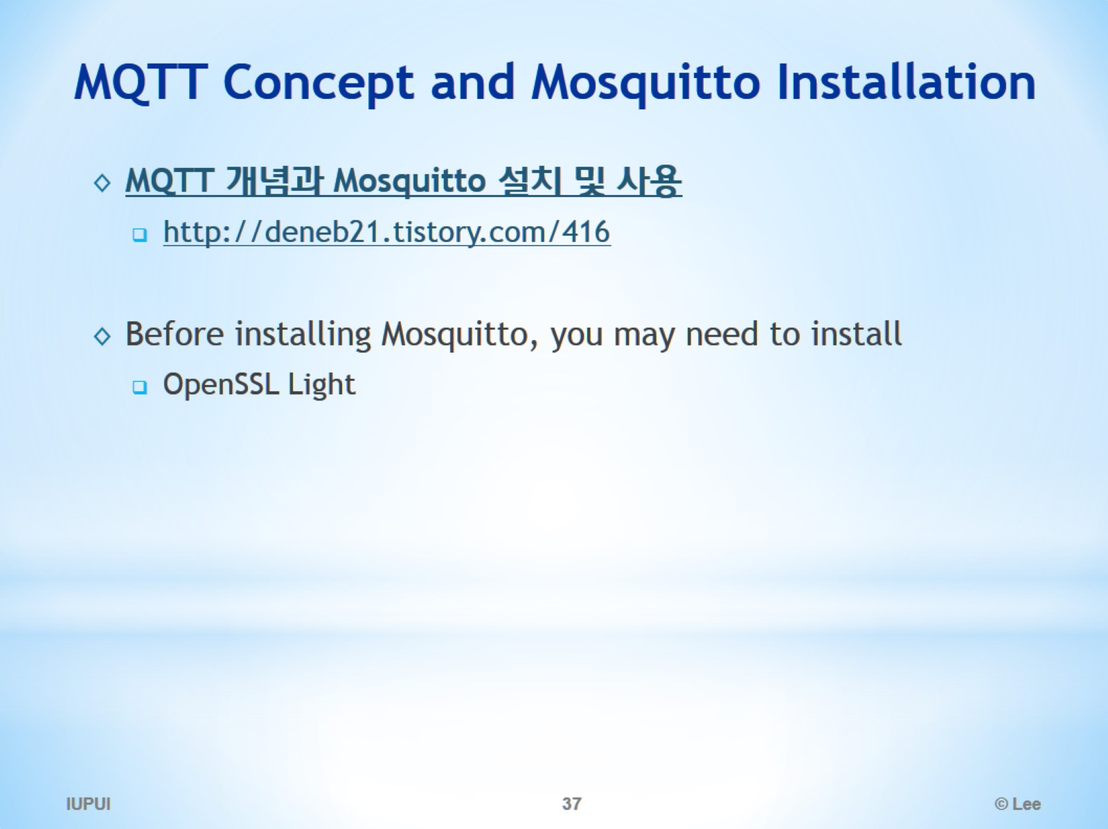
MQTT Concept and Mosquitto Installation

Slide 38
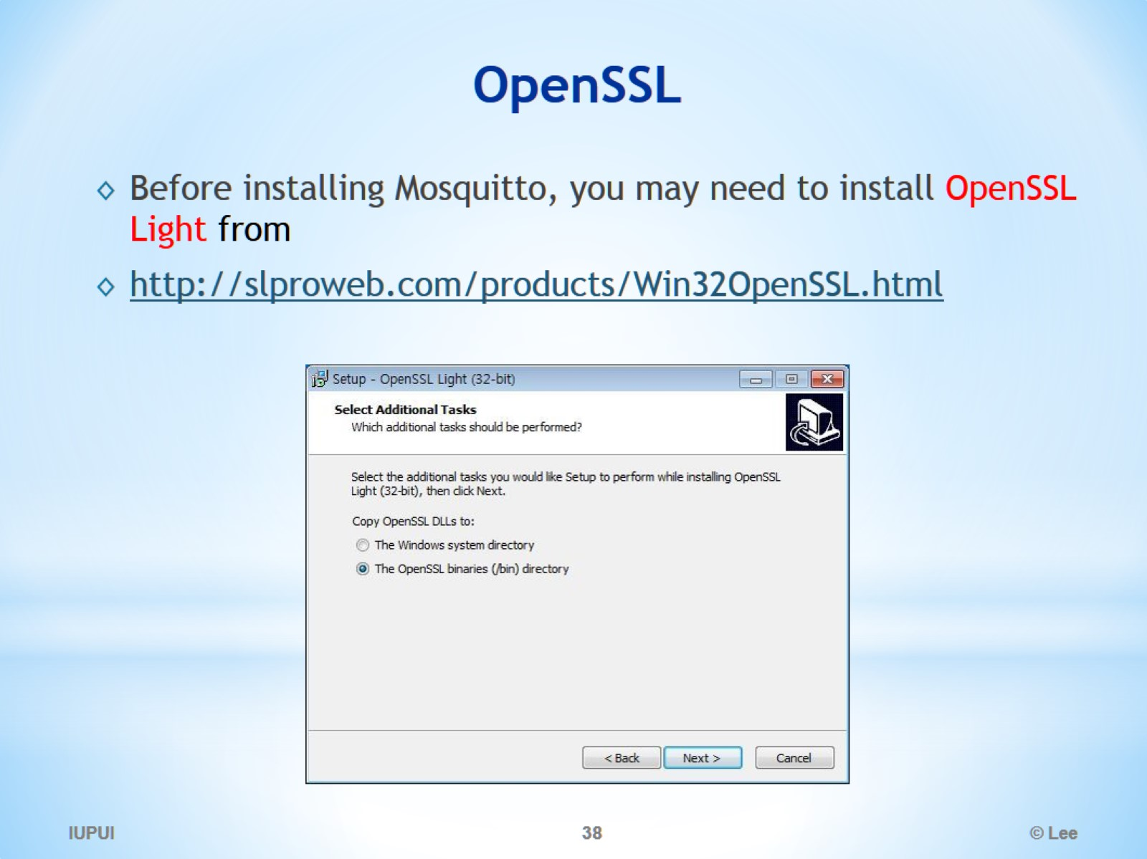
OpenSSL

Slide 39
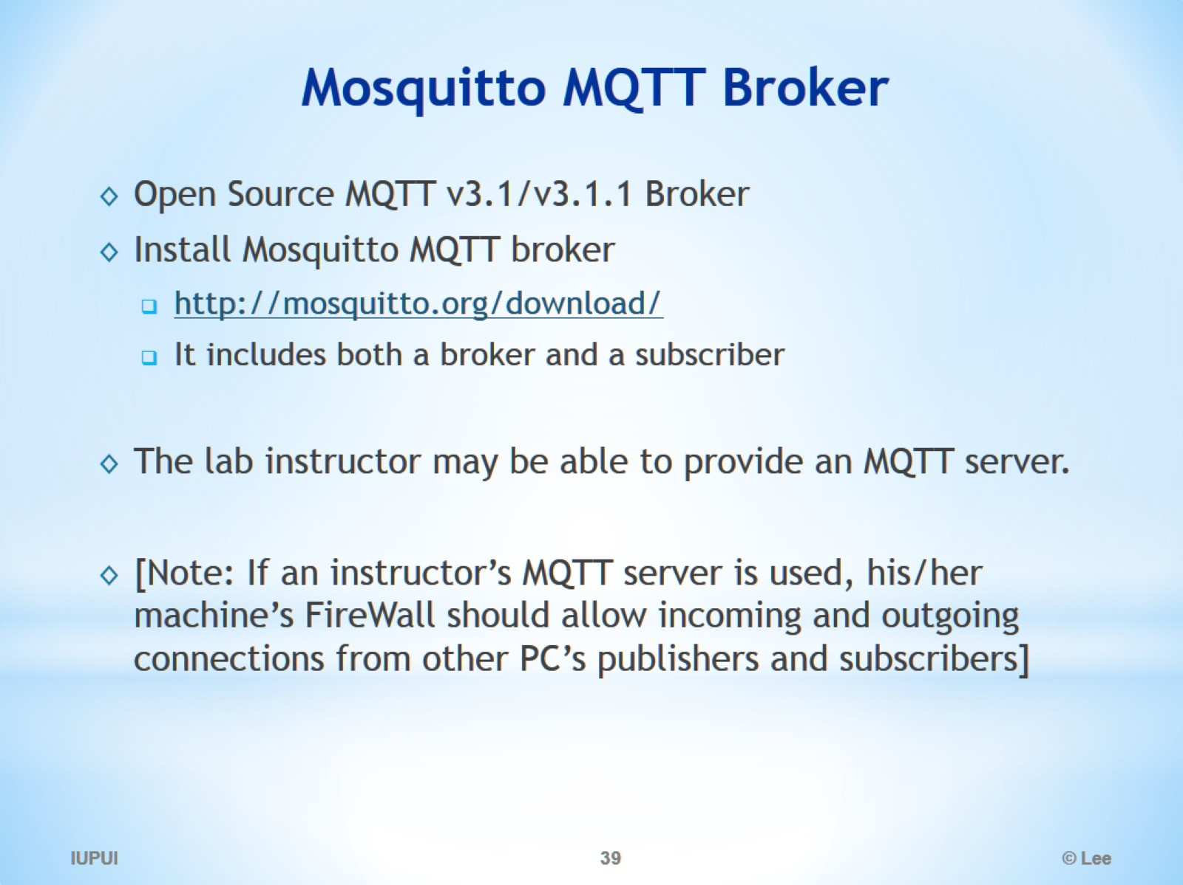
Mosquitto MQTT Broker

Slide 40
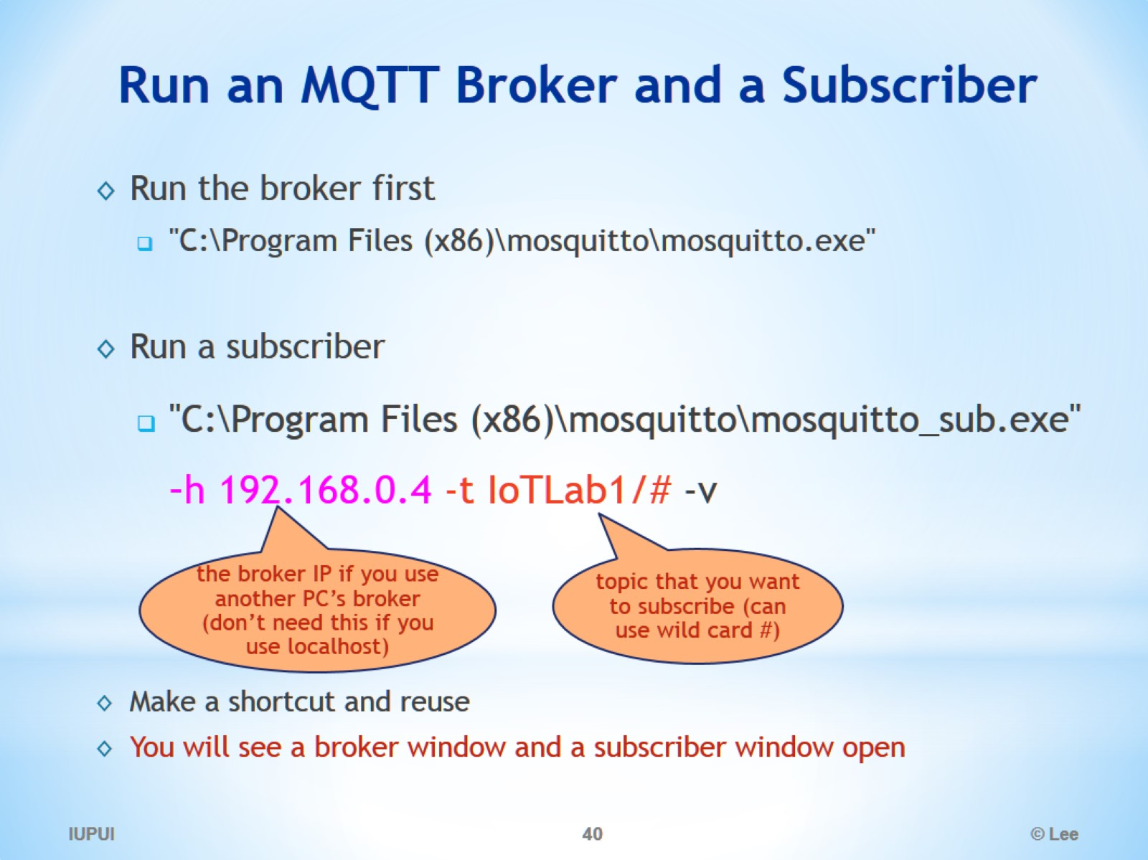
Run an MQTT Broker and a Subscriber

Slide 41
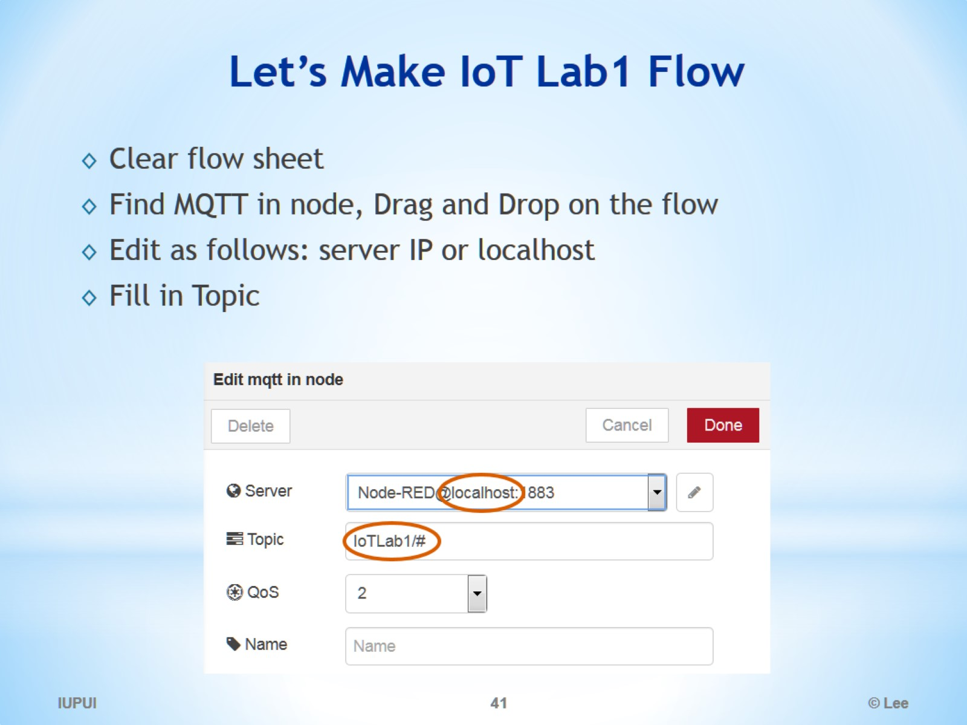
Let’s Make IoT Lab1 Flow

Slide 42
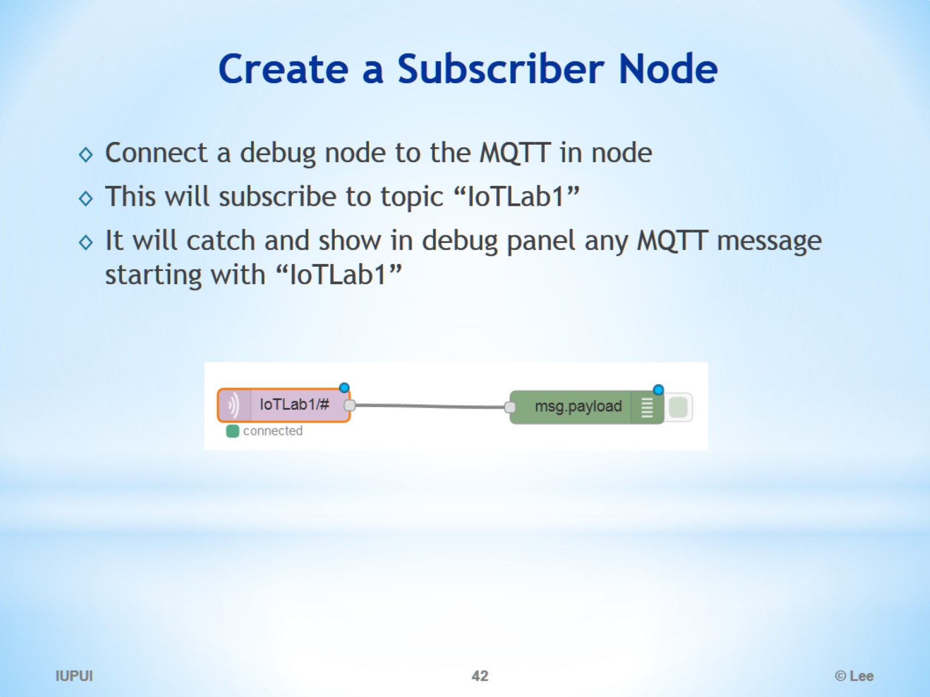
Create a Subscriber Node

Slide 43
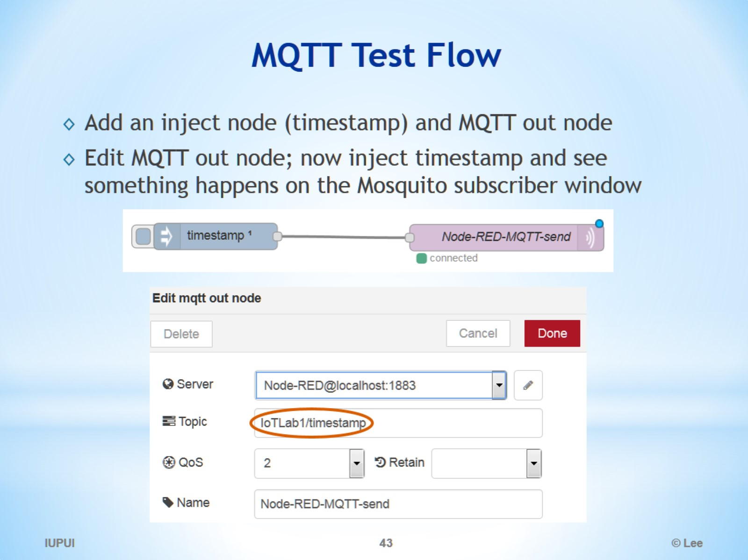
MQTT Test Flow

Slide 44
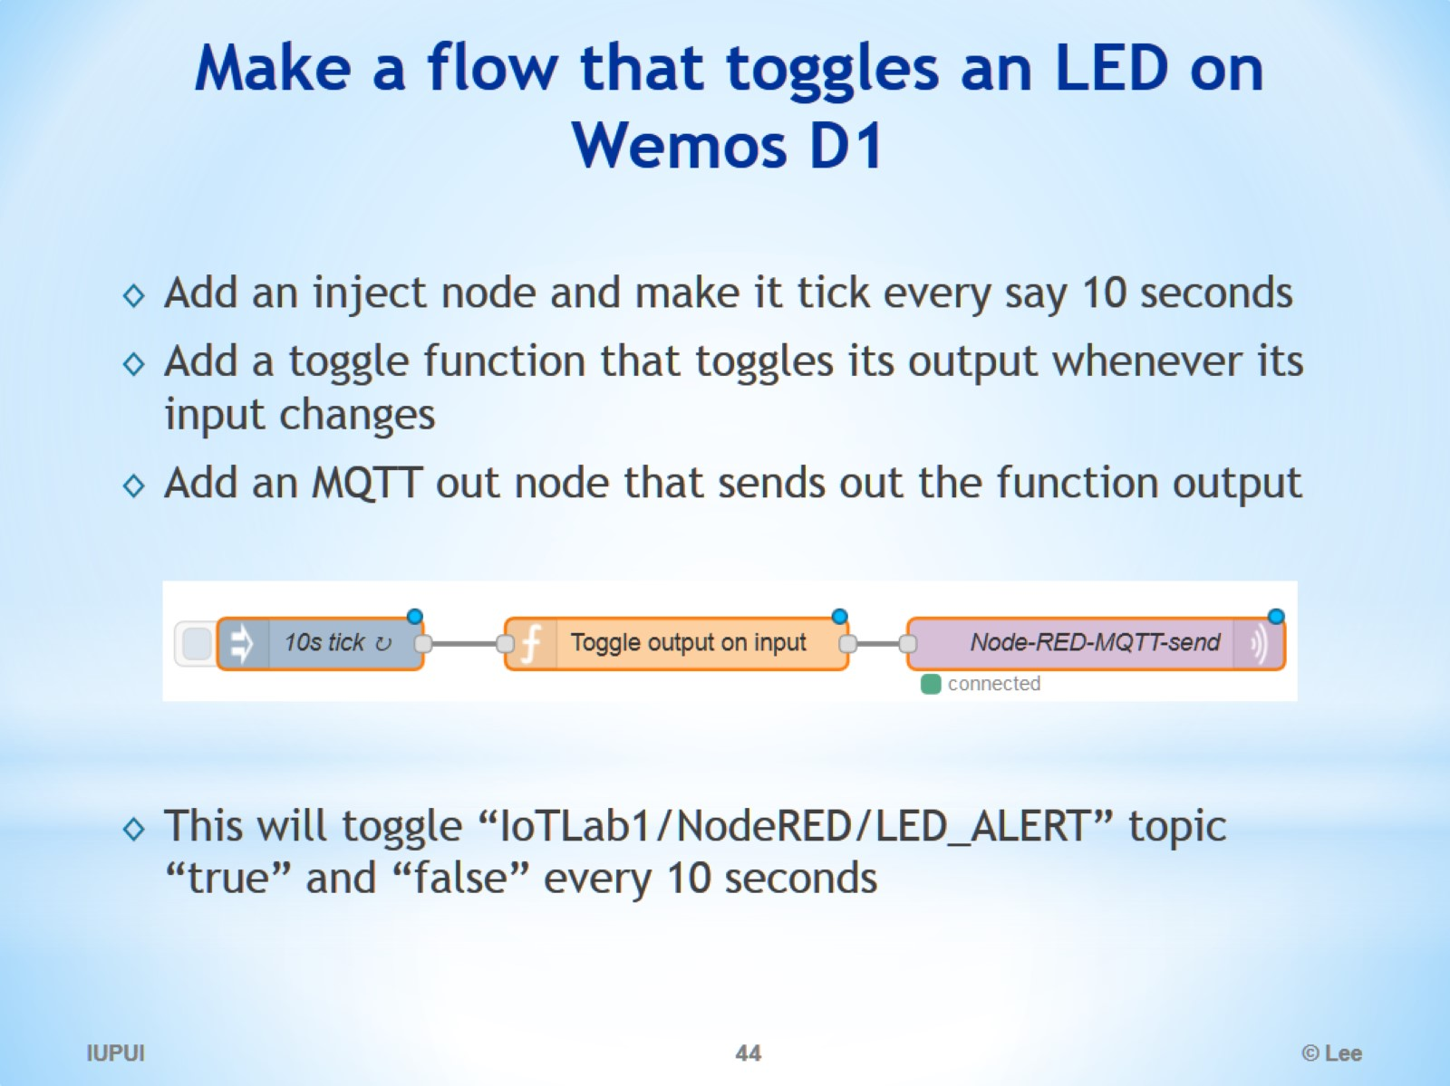
Make a flow that toggles an LED on Wemos D1

Slide 45
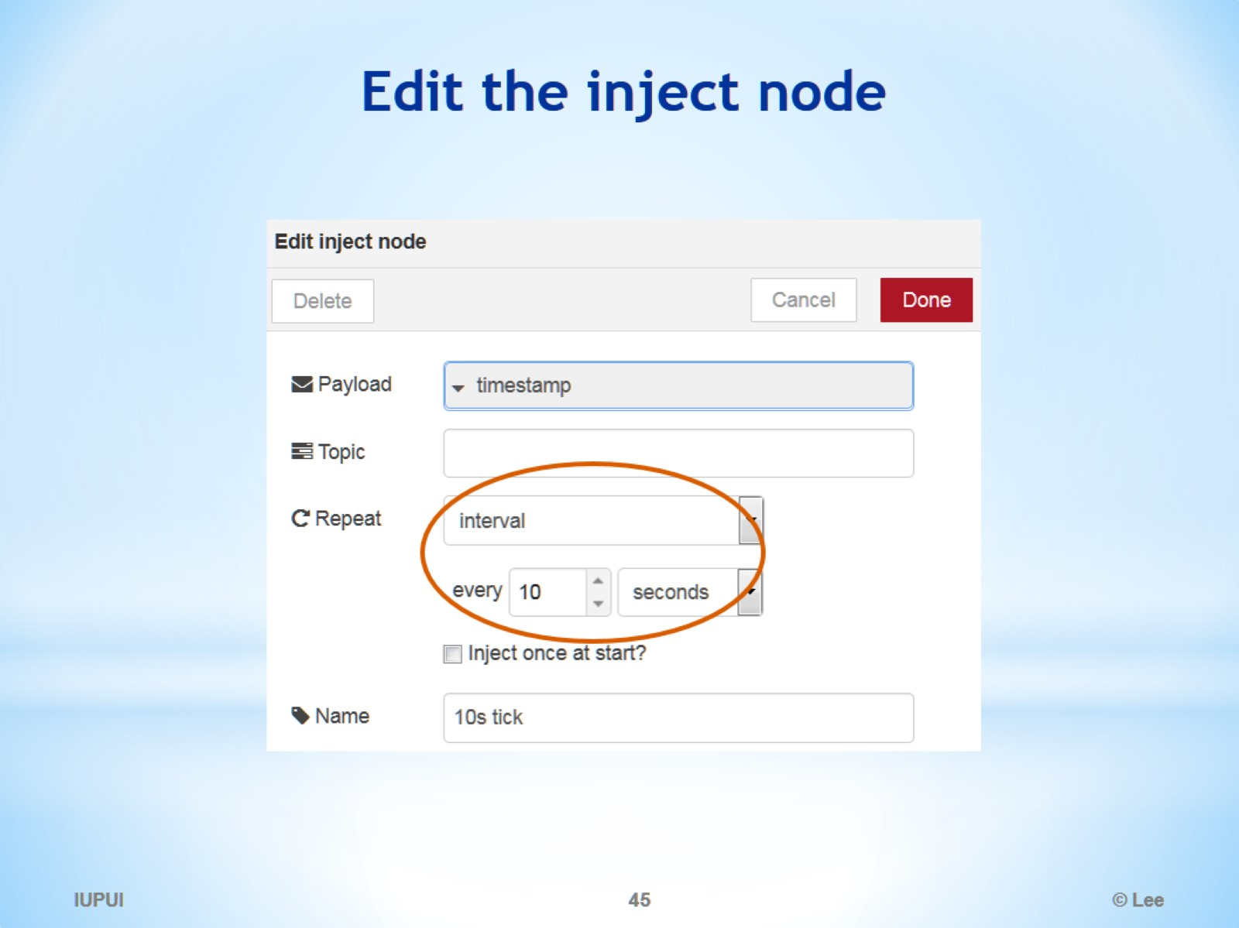
Edit the inject node

Slide 46
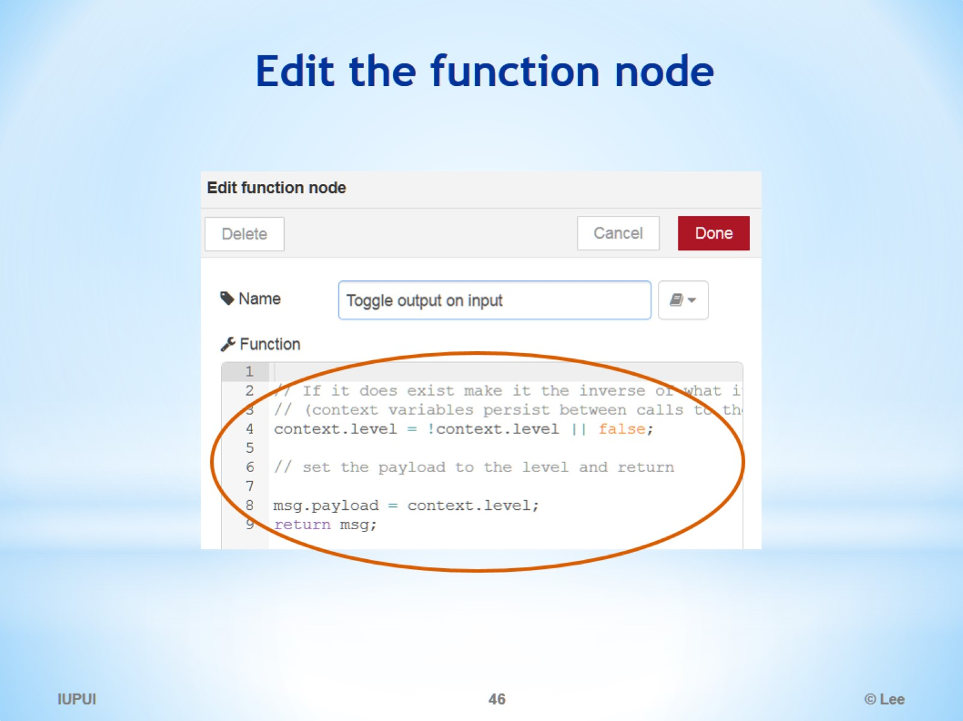
Edit the function node

Slide 47
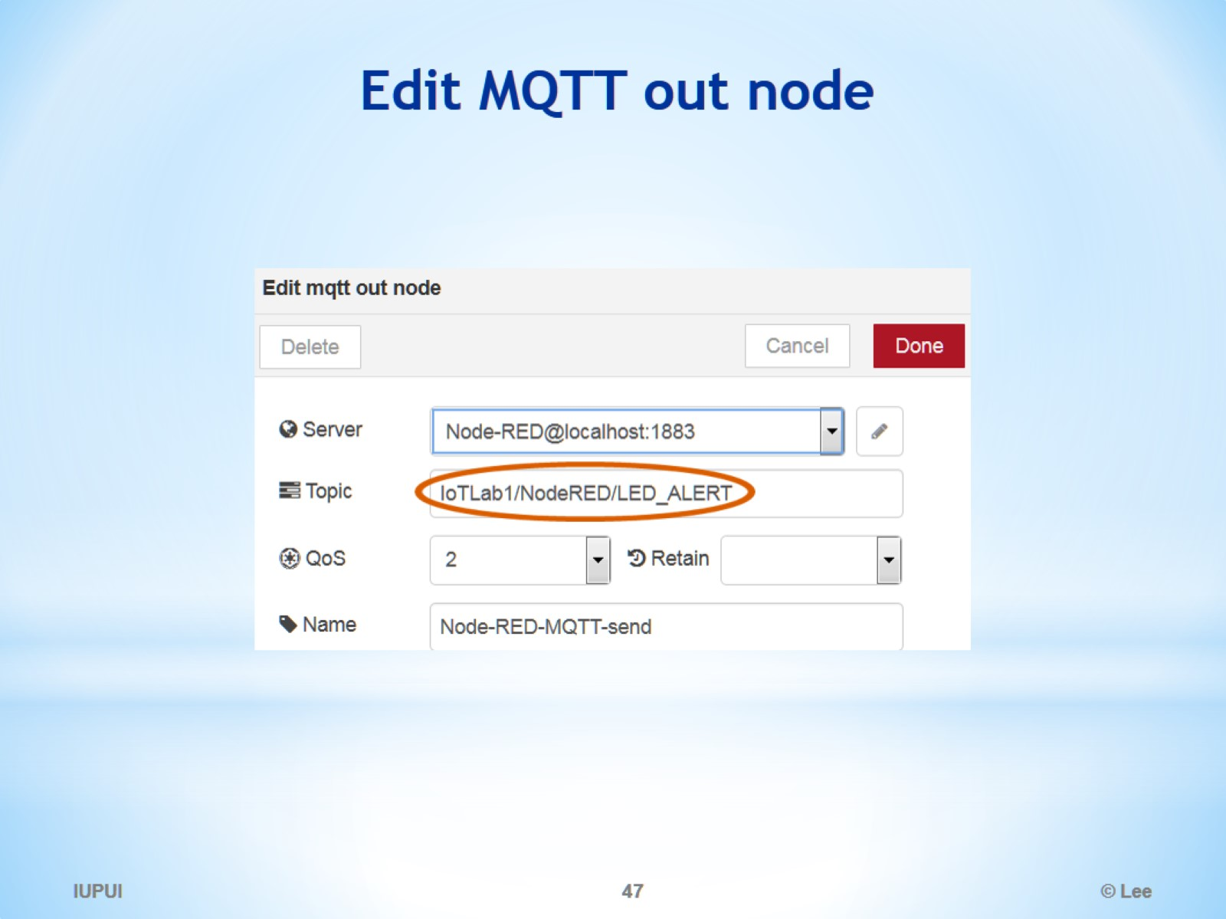
Edit MQTT out node

Slide 48
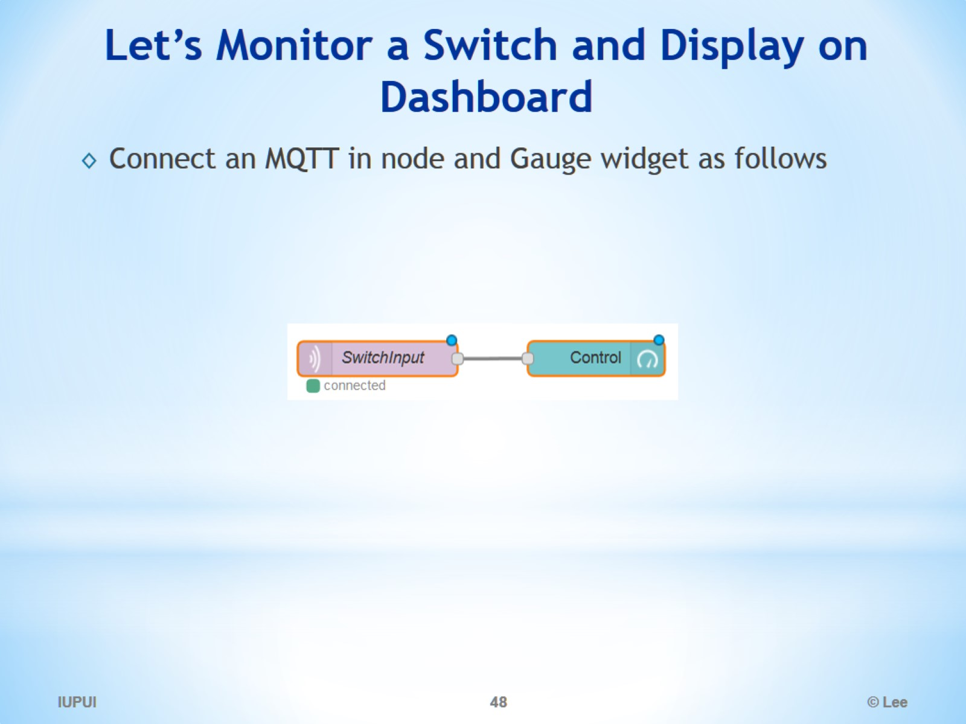
Let’s Monitor a Switch and Display on Dashboard

Slide 49
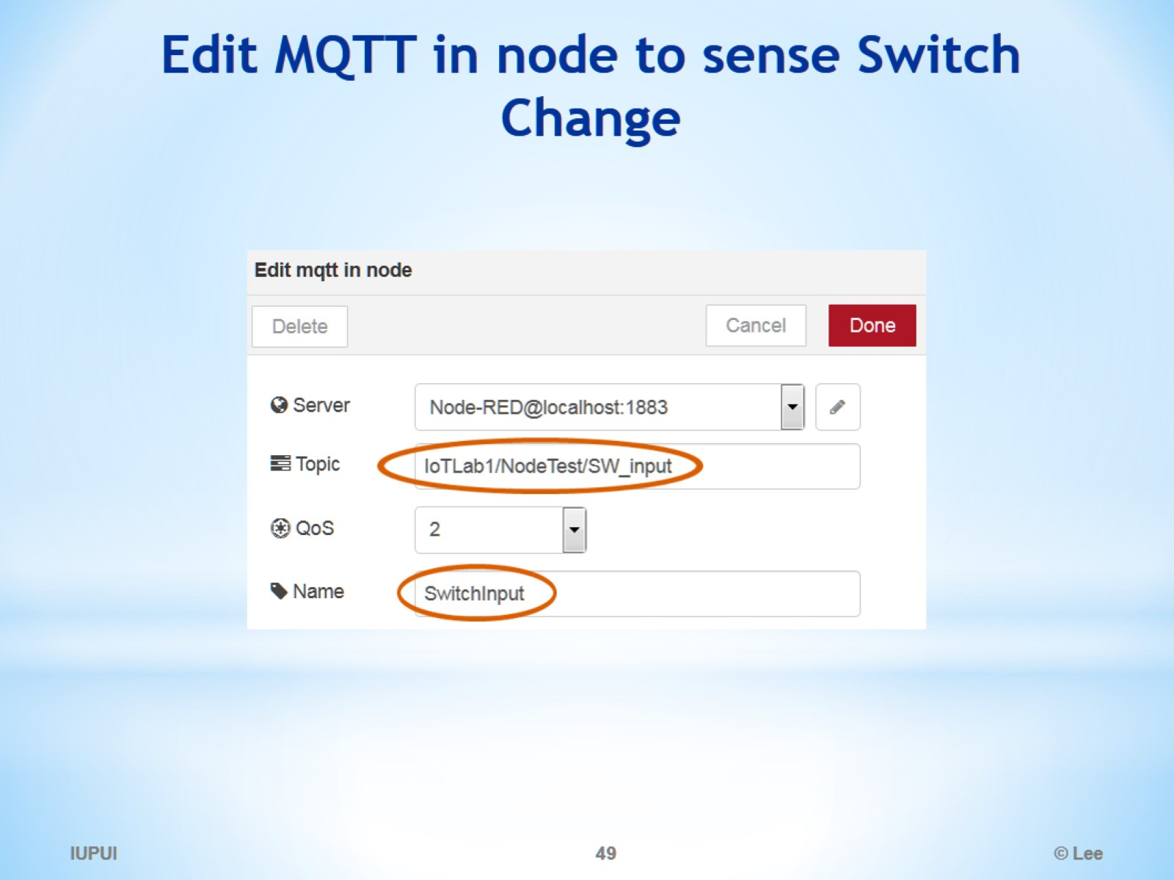
Edit MQTT in node to sense Switch Change

Slide 50
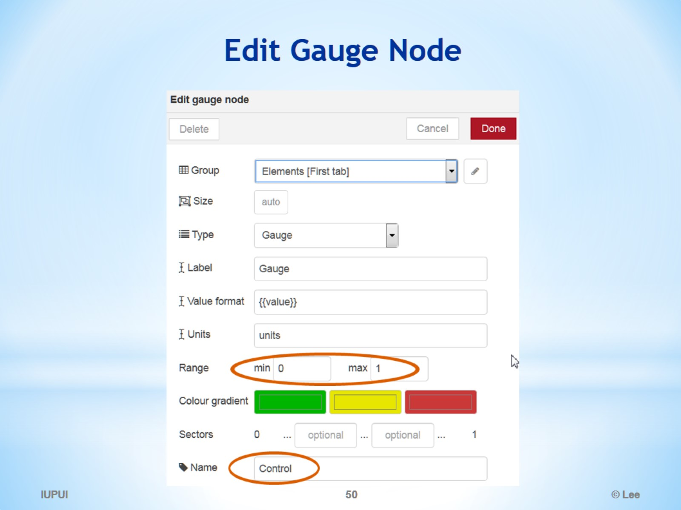
Edit Gauge Node

Slide 51

Electronics 101

Slide 52

Electronics 101 - Photoresistor

Slide 53

Electronics 101 – Switch

Slide 54

NodeRED Lab: Components needed

Slide 55

Connection

Slide 56

What is Wemos D1 board

Slide 57

WeMos D1 Pin Layout

Slide 58

How to connect my ESP8266 to Flow

Slide 59

Setup target board, port, speed, etc.

Slide 60

How to connect my ESP8266 to Flow

Slide 61

Open NodeRED Dashboard

Slide 62

Complete Flow

Slide 63

IGNORE THE REST

Slide 64

Node-RED Arduino Tutorial

Slide 65

Install Node-RED Arduino library

Slide 66

Files - Examples - Firmata - SimpleDigitalFirmata

Slide 67

Import the Blink node

Slide 68

Modify Arduino output node

Slide 69


Slide 70


Slide 71

Running on IBM Bluemix

